Slide 1
Security, Certificates, and
System Manager - 808
Chris Clauss – ConvergeOne
Get this presentation – http://bit.ly/iaugpres

Slide 2
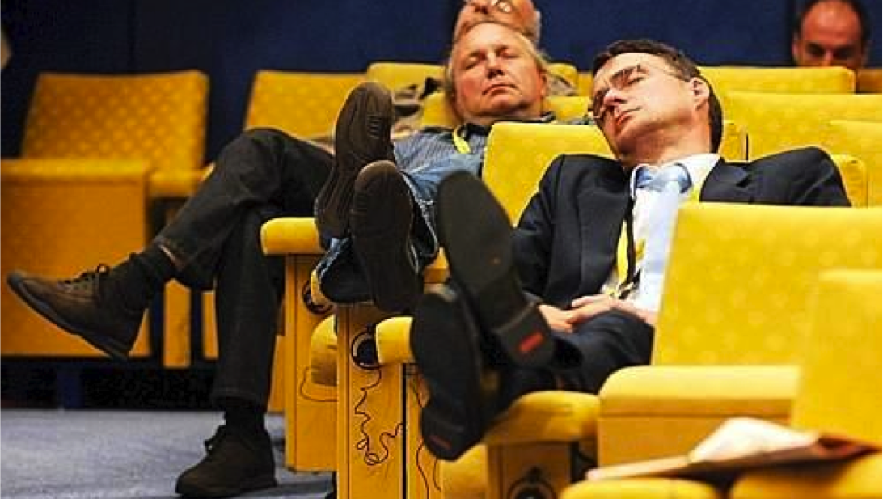
Thanks for coming!
Please ask questions!
Let’s make this time together worthwhile!

Slide 3
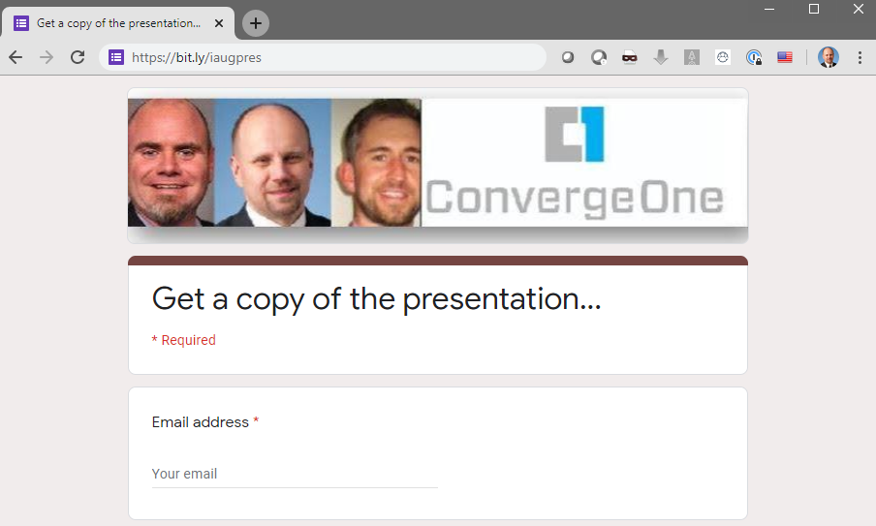
Get this presentation
http://bit.ly/iaugpres

Slide 4

What is or will be driving security in your organization?
Devices
  Remote Worker
  Internet Connected Device
  BYOD
  Hosted Solutions
Security Teams
  Are they asking for audits?
  Are they taking notice of U/C?
  Is management worried (news)?
What needs to be secured?
  Voice conversations
  The systems themselves
EVERYTHING needs to be secured.

Slide 5

What we need to protect
Security teams use the acronym “CIA” to identify 3 key areas
Confidentiality
Privacy of data. Insure that data is kept private during transport and at rest (for example a VOIP call on the wire or a voice message on the hard drive).
Insure only those who must have access have access.
Integrity
Data must not be changed in transit, and steps
must be taken to ensure that data cannot be
altered by unauthorized actors.
Availability
Maintaining and protecting systems to keep them up and running to process data. Protect against actors that wish to harm or deny service.

Slide 6

Who do you need to protect against?
Depending on the industry you are in, or the specific company you work for…
Nation / States
Corporate Competitors
Hackers / Hacktivists
Organized Crime – hacking for
information / toll fraud / or planted
employees in call center staff
Opportunists
Company Insiders
Ask yourself - what can someone with bad intentions do with my UC system?

Slide 7

We use encryption to protect data.
Lock data – unlock with a key
The sender encrypts the data with a key.
The receiver uses the key to unlock the data.
This is symmetric encryption – both sides use the same key.
Problem is key distribution. How can we share the keys in a secure fashion?

Slide 8
We use encryption to protect data.
Public Key Encryption
Sender
Instead of sending a key, we send a lock. Only the recipient has the key to unlock the data.
Based on mathematic formulas that create a key pair. One private and one public.
Data encrypted with one key can be decrypted with another.
Send uses public key to encrypt data, receiver uses private key to decrypt.
Public Key
Private Key
Recipient

Slide 9
Encryption provides confidentiality, but does not provide authentication.
To provide authentication, the sender can “sign” the data with their own private key. This is the sender’s IDENTITY certificate.
The receiver can decrypt the signature using the sender’s public key.
Problem remains, how can we be sure the sender is who they say they are?
Chris
Chris

Slide 10
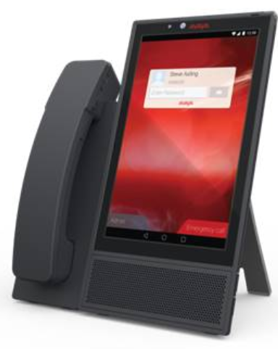
In an Avaya Infrastructure
System Manager can be the “CA”
System Manager can serve as the certificate authority for Avaya servers.
System Manager provides signed certificates for Session Manager, CM, SBC, etc.
Customers can use a public CA. In this case System Manager becomes a subordinate CA.
Chris
Chris
TRUST
System
Manager C/A

Slide 11

Why do we need certificates?
We use TLS to provide encrypted links between servers.
TLS encrypted links provide confidentiality protecting the communications from eavesdroppers.
Certificates provide AUTHENTICATION. They provide the mechanism to ensure that the two parties communicating with one another are actually who they claim to me.

Slide 12
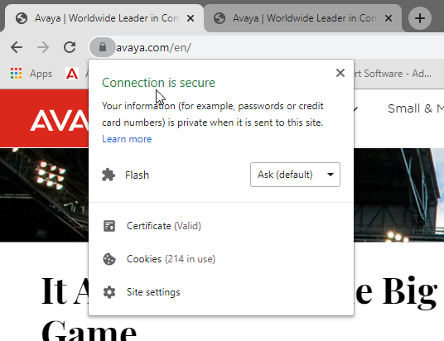
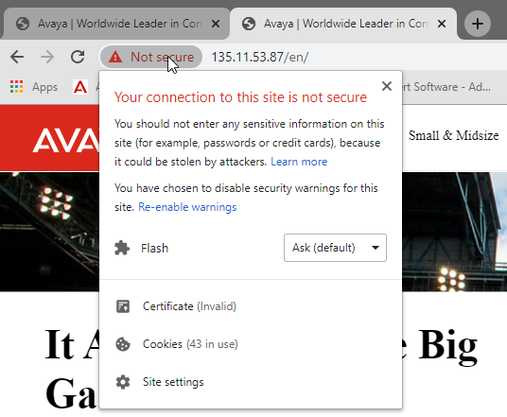


Example
A web site that is claiming to be your secure will provide a certificate that matches the server name / domain name you are connecting to.
https://www.avaya.com same as https://135.11.53.87

Slide 13
Authentication is really important, but…
Authentication is really important for any sites that require logins, provide secure information, etc.
Authentication may not be that important for UC systems were server to server communications are usually “hard wired” on fixed IPs or configured to only communicate with internal servers.
Good or bad, for TLS encryption to work, certificates are required.

Slide 14

A certificate includes the following
The identity (subject) of the certificate – usually server name.
Certificates are (almost always) signed by a third party.
Each system that is negotiating the security will not trust the certificate unless it also trusts the signer.
The certificate also has a validity period – best practice at this time is not more than 730 days (2years)
The certificate will have a complexity – determined by a bit length – best practice is 2048 bits at a minimum – 4096 bits more common.

Slide 15
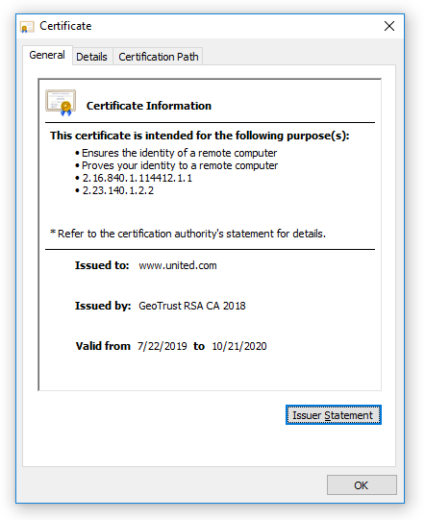
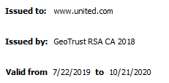
Looking at a certificate

Slide 16

A certificate contains two important parts
The identity portion – usually the name of the server.
  Identity can be defined in two places – the subject and the SAN
    Subject field (DN) - usually the FQDN of the server – server.company.com
    Subject Alternative Name (SAN) – the best practice location for the server identity
      SAN may contain several entries including FQDN, short host name, IP.
The signature portion – information on what certificate authority signed the certificate
  The signature references the certificate authority.
  The signer is WHAT IS TRUSTED.

Slide 17

Example of trust
Simple example – Passport
  A passport is a certificate. It proves that you are who you say you are.
  When you enter a country, you must provide the passport
    The customs official does not trust you, but they trust your passport
    Why do they trust your passport?
      The passport is issued by a respected authority.
      The passport contains customer security features to prevent fraud.

Slide 18
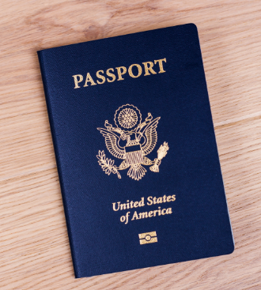
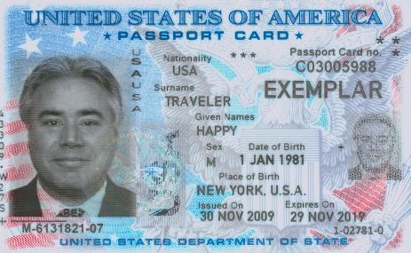
Here is a “real world” certificate…
Certificate has
An identity
An Issuer
A Validity Period
Complexity

Slide 19
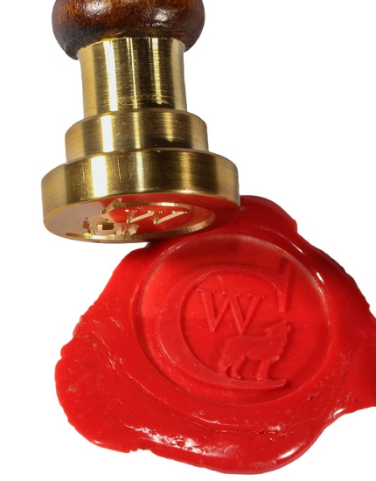
So who signs certificates?
Self signed – example a personal check signed by you.
Certificates signed by a certificate authority
  Private Certificate Authorities – example is a company ID card signed by HR.
    System Manager
    Windows Server Certificate Authority
    openSSL on Linux
  Public / 3rd party Certificate Authorities – example is a passport issued by a government.
    GoDaddy
    Verisign
    Digicert

Slide 20

Self signed certificates
A certificate that is generated by the server for itself.
The identity of the certificate and the signer are the same.
Some organizations consider any self signed certificate a security risk.

Slide 21
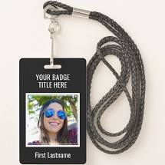
Private / Public Certificates
The certificate is generated by a different server
For private Certificate Authorities – may be System Manager or a Windows Server. Systems must import the private certificate authority “root” certificate before they will trust the identity certificate.
For public Certificate Authorities – external company like Verisign or GoDaddy. Most operating systems trust many of these by default.
  Public Certificate Authorities charge for generating certificates

Slide 22

Certificates can have a hierarchy.
Certificates can be signed by an “intermediate” certificate authority.
If I trust the intermediate CA, and I trust the higher level CA, then I trust the certificate.
Intermediate CA is used to enhance security and for ease of management of certificate requests.

Slide 23
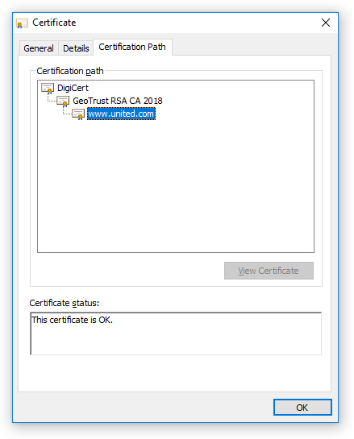
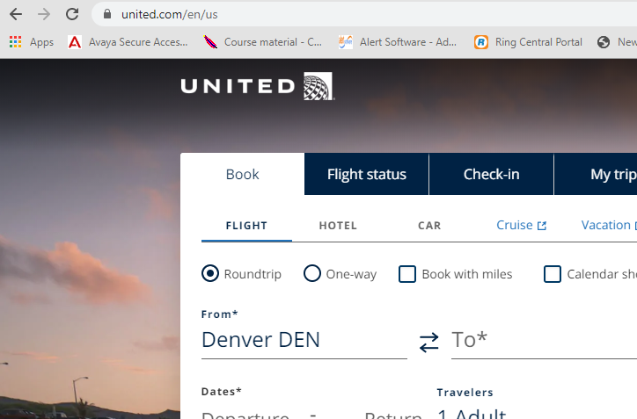
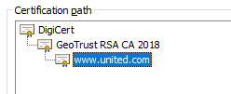
Example certificate with an intermediate CA

Slide 24
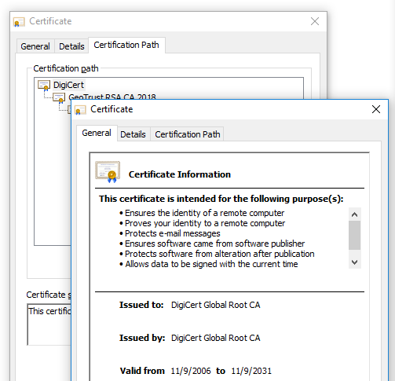
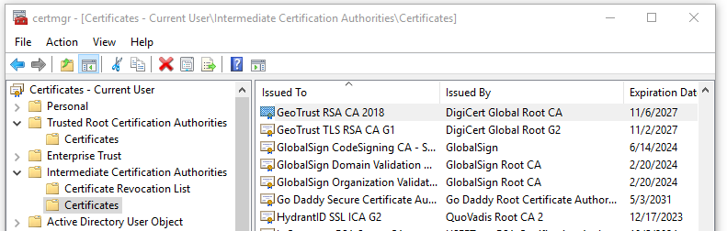
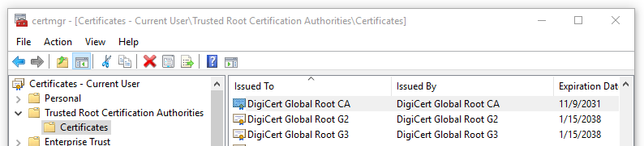
Why does my computer trust “united.com”

Slide 25
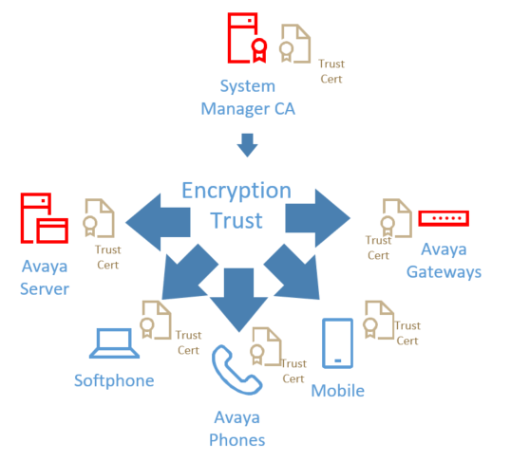
System Manager self signed CA

Slide 26

System Manager self signed CA
Pros
Works out of box
Automatically issues and deploys and redeploys certificates for managed elements (SMGR / SM)
Aura environment stands alone
Cons
PKI is independent of other PKI
No enterprise branding
Must distribute PKI to endpoints
Simplest management for Aura certificates
SECURITY

Slide 27
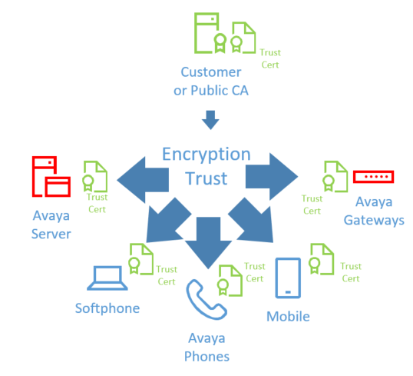
Enterprise Private CA / public CA

Slide 28
Enterprise Private CA / public CA
Pros
Provide enterprise asserted trust
Certificates may already be distributed to client devices.
Cons
Must manually establish PKI trust chain to Aura managed devices.
Must create Certificate signing request and import identity certificates
No automatic issue or re-issue of certificates.
Relatively straightforward deployment. Not require for all devices. (Can generate identity certs only for required)
SECURITY

Slide 29
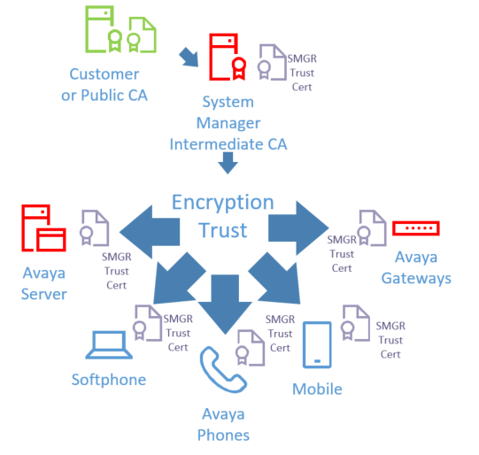
SMGR as subordinate CA

Slide 30
SMGR as subordinate CA
Pros
Provides enterprise certs.
Certificates may already be distributed to client devices.
Automatically issues and deploys and redeploys certificates for managed elements (SMGR / SM)
Cons
Enterprise must allow sub-CA
Trust chain must be distributed to all Aura elements
Difficult to implement.
SECURITY

Slide 31
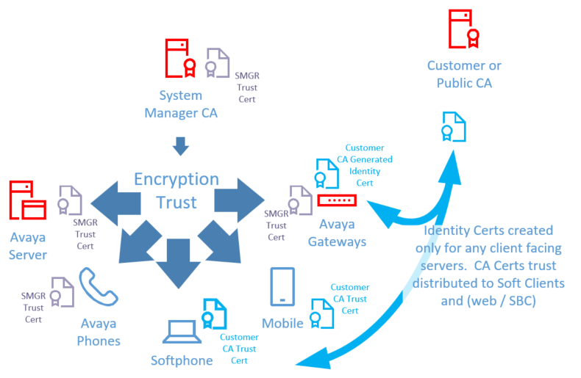
SMGR for Aura / Customer CA

Slide 32
SMGR for Aura / Customer CA
Pros
Provides enterprise certs where needed.
Allows SMGR to provide certs for Aura
Certificates may already be distributed to client devices.
Automatically issues and deploys and redeploys certificates for managed elements (SMGR / SM)
Aura managed certs for most “internal” servers.
Cons
Two PKI authorities
SECURITY

Slide 33

Configuring Avaya CM / Session Manager for secure communications
To configure the solution, we need
to do the following
Validate capabilities
Issue certificates
Configure secure signaling
Configure secure media
We will focus on using SMGR for certs – ping me after for configuring CM / ASM to secure talk path.

Slide 34
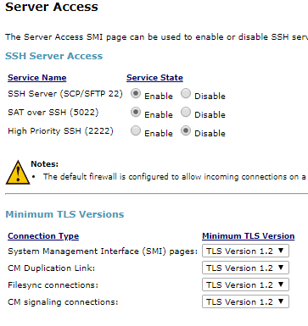
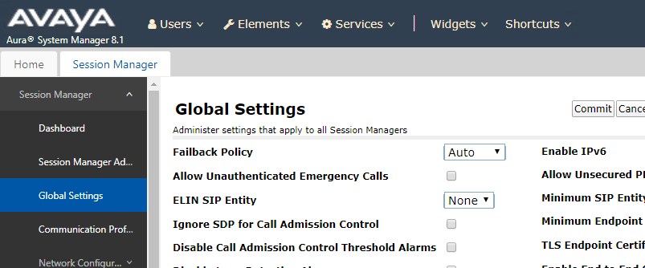
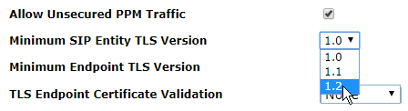
Verify system capacity for TLS (R7.1+)
Minimum TLS version support was added in Aura R7.1. Important because compliance generally requires minimum TLS version 1.2

Slide 35
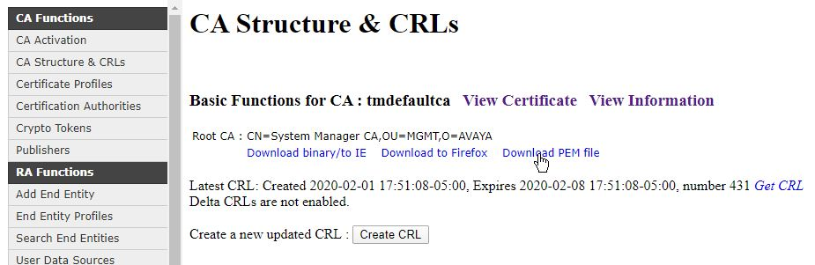
Generate server certificate using SMGR
Before Enabling the TLS for H323 on any stations, install TLS certificates.
H323 endpoints will download the cert from the Utility server at boot.
Login go the System Manager web page and go to
> Services / Security / Authority
Note – your company may not allow SMGR to be the Certificate Authority
Download SMGR root certificate to distribute to servers and endpoints.

Slide 36
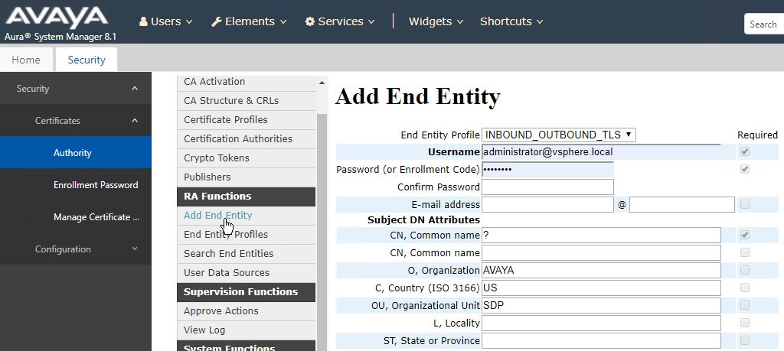
Register CM in the SMGR Registration Authority
Register the CM in the SMGR Registration Authority
Use CM FQDN

Slide 37
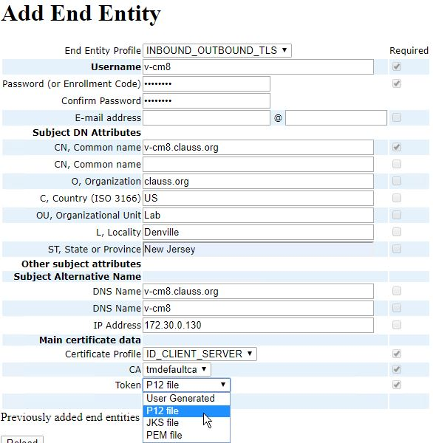
Register CM in the SMGR Registration Authority
Username –
Password – need it later
CN – usually the DNS name
Next few fields are optional
SAN is very important
Add DNS name, short DNS name
and optionally IP address.
CA is usually tmdefaultca for SMGR
Use P12 file to generate cert with private key. No CSR required.
SMGR can also sign CSR. Select User Generated.

Slide 38
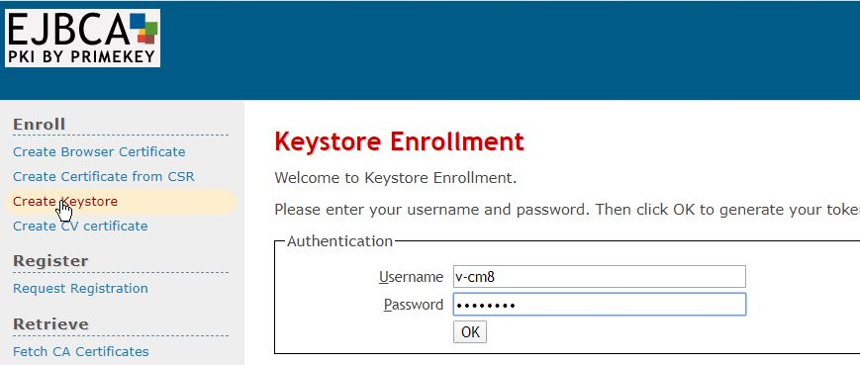
Create the CM certificate
Create the signed server identity certificate that will be imported into the CM using the EJBCA Administration screen.

Slide 39
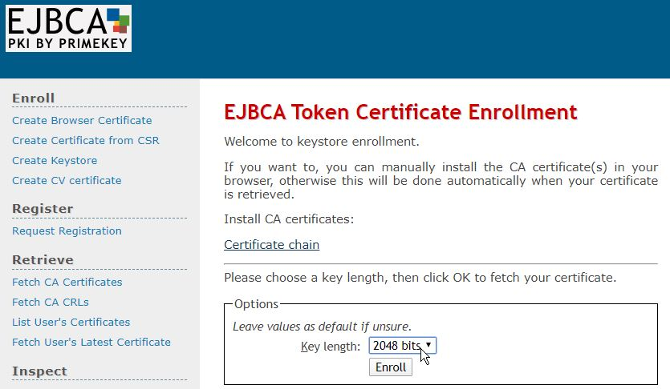
Create the CM certificate
Create the signed server identity certificate that will be imported into the CM using the EJBCA Administration screen.

Slide 40
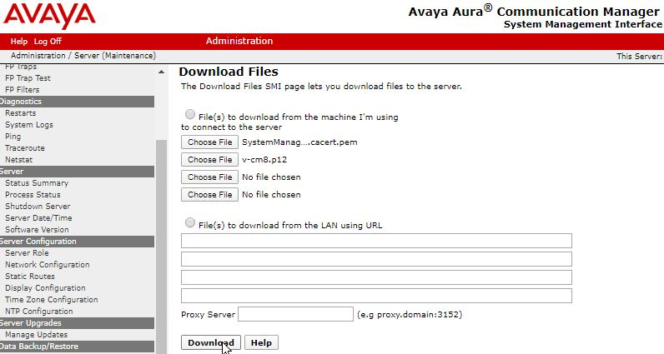
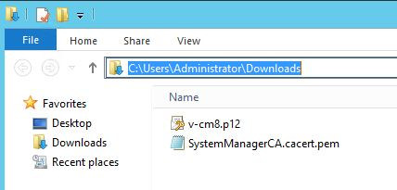
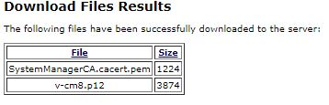
Upload the certificates to the CM
Download the net CM certificate and then upload both files to the CM.

Slide 41
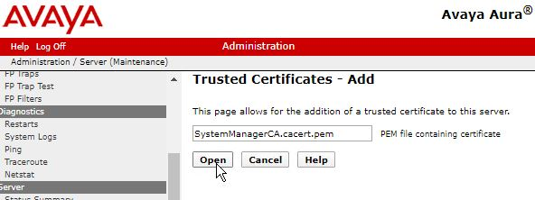
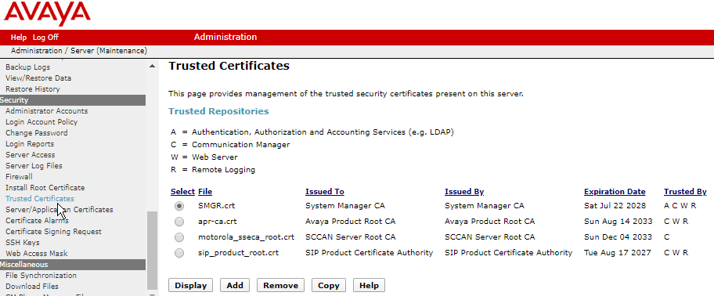
Install SMGR trusted certificate
Install the SMGR certificate that was uploaded into the trusted certificate store.

Slide 42
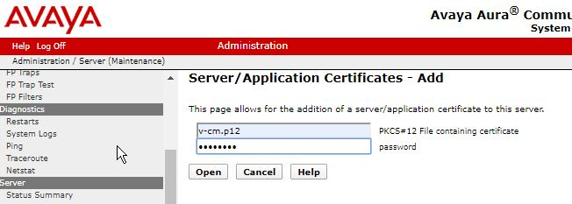
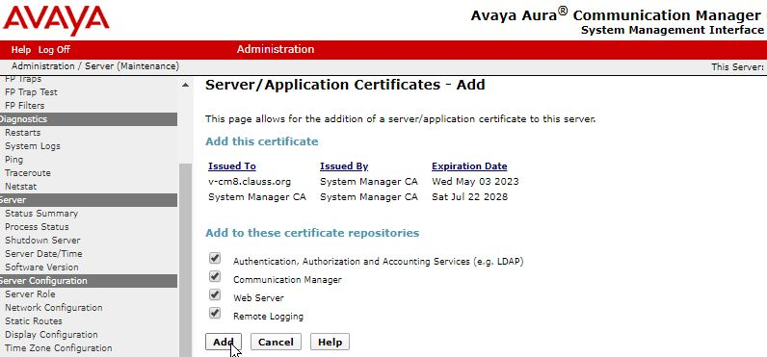
Install CM server certificate
Install the CM server certificate that was signed by the SMGR.

Slide 43
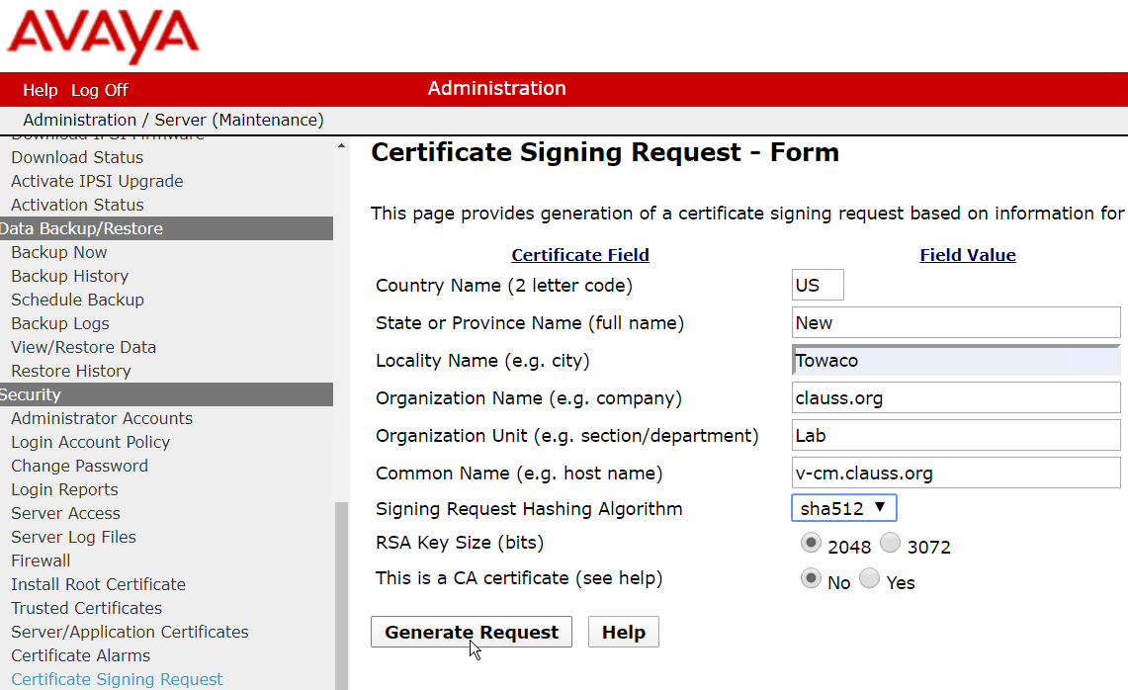
What if I am not using SMGR
You will create a certificate request from your application…

Slide 44
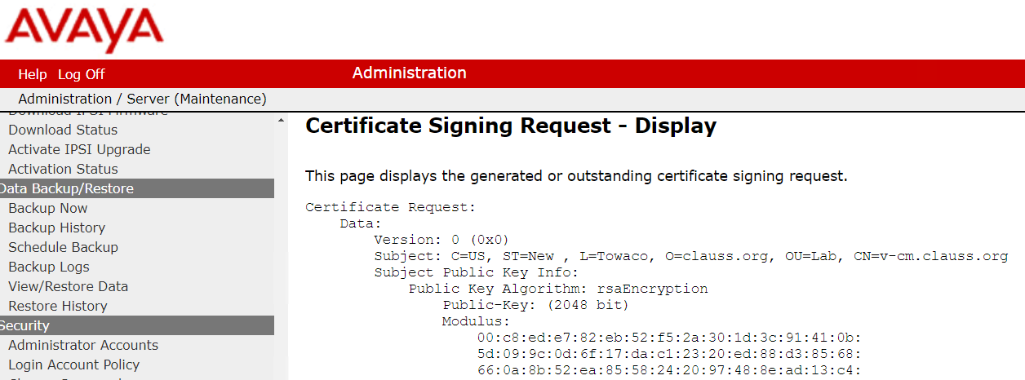
What if I am not using SMGR
Information on the “CSR” will be displayed…

Slide 45
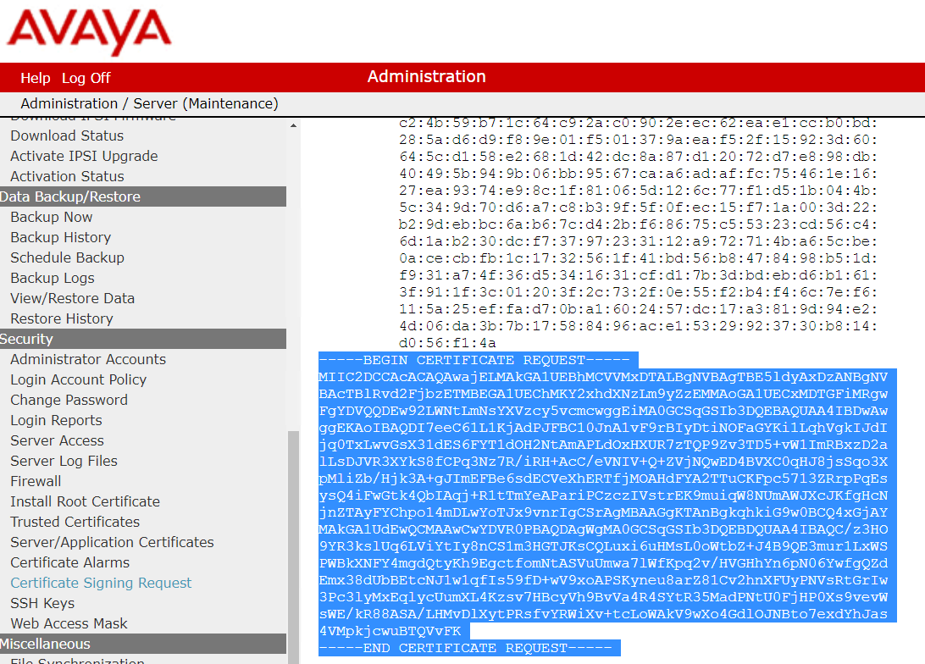
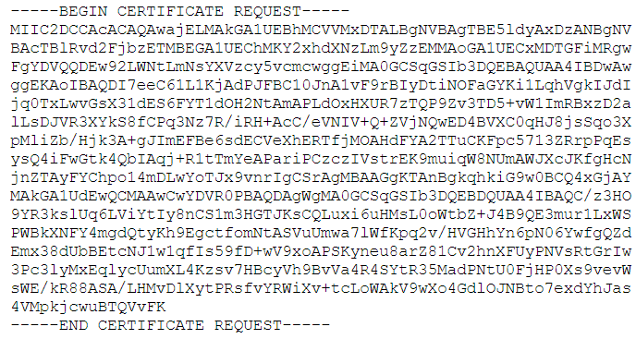
What if I am not using SMGR
Scroll down and copy the request to a text file or paste it into the browser on your CA web site…

Slide 46
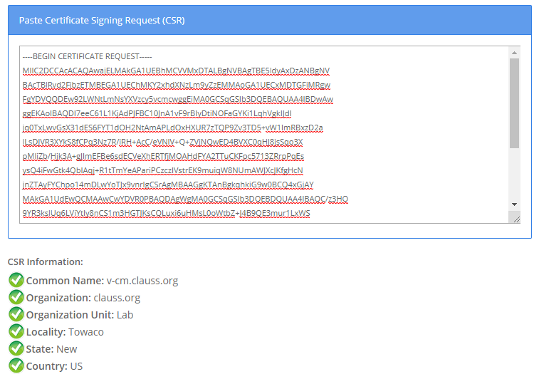
We can view the contents of the request.
https://www.sslshopper.com/csr-decoder.html

Slide 47

And do this for…
Every system in the Avaya Aura Solution. You will need to generate server identity certificates for:
CM servers / ESS / LSP
CM Gateways
CM Media Servers
Session Manager Servers
AES Servers
Messaging Systems
Any system that will process call
signaling or RTP media.

Slide 48
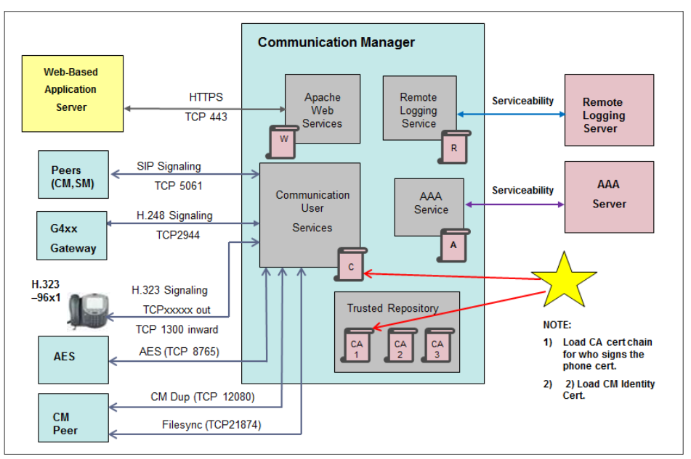
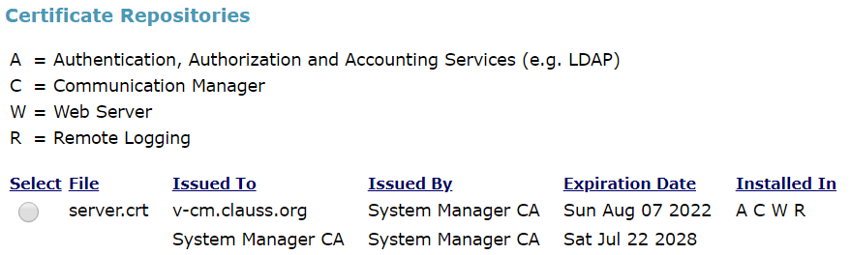
Examples of TLS links used by cm

Slide 49

Recommendations
Get ahead of these issues.
Understand your companies security policy.
Make sure certificates have proper SAN and expirations – 2 years or less for end user facing certificates.
Have a dialog with security teams.
Don’t let certificates expire! Your systems stop working.
Understand your corporate policy for
security, encryption, and certificates.

Slide 50

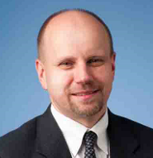
What’s the best way for you to get help with scans?
Find the best partner – here at the show!
Please fill out your session survey! Session 808
Please tweet about the presentation if you liked it - @clauss
Come ask us questions
www.convergeone.com
Thanks for attending!
Chris Clauss
cclauss@convergeone.com
Get this presentation – http://bit.ly/iaugpres

