Slide 1
Security, Certificates, and the System Administrator

Slide 2


Chris Clauss
Manager, Avaya UC Engineering
Collaboration
ConvergeOne

Slide 3

Feel The Impact
ConvergeOne
Notes:
ConvergeOne is an IP Enabled, services led technology company which provides a holistic environment for secure connected customer experiences for our clients.

Slide 4
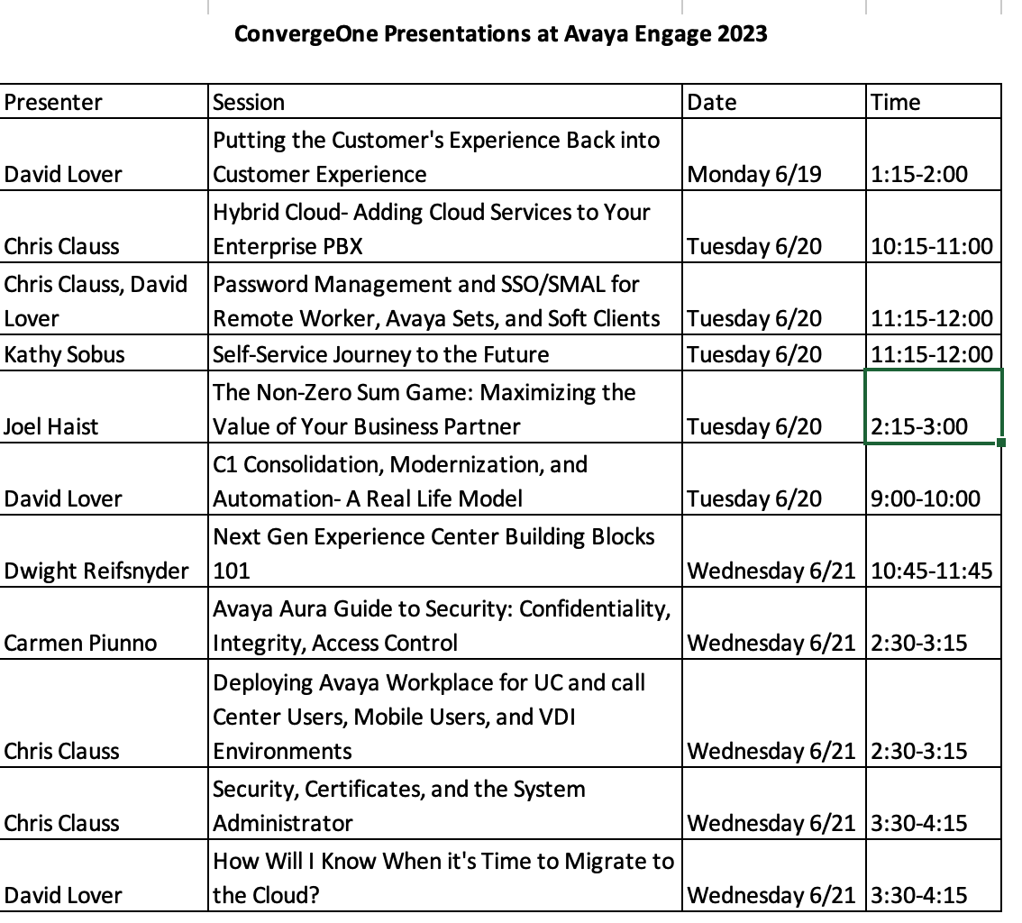

Visit our Other Sessions!

Slide 5

What is or will be driving security in your organization?
Devices
  Remote Worker
  Internet Connected Device
  BYOD
  Hosted Solutions
Security Teams
  Are they asking for audits?
  Are they taking notice of U/C?
  Is management worried (news)?
What needs to be secured?
  Voice conversations
  The systems themselves

Slide 6
A brief introduction to security…
A security system must provide: (CIA+A)
  Confidentiality
  Integrity
  Availability
  Authentication
Security systems must make the cost of attacking an asset higher than the value of the asset being attacked.
Failure to provide adequate security:
  Exposure or loss of information
  Loss of time, money, or capital resources.
  Legal exposure (liability).
  Loss of credibility, trust, or market share.

Slide 7
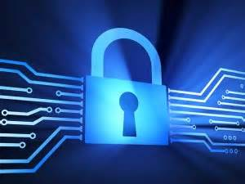
A brief introduction to security…
Confidentiality
  Ensuring no eavesdropping – keeping information private.
Availability
  Protecting from Denial-of-Service attacks, System Hacks
Integrity
  Ensure data cannot be manipulated.
Authentication
  Insure the identity of people or applications.

Slide 8



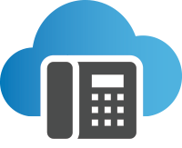
U/C Security is Different from Data security
Layer 3 attack
Layer 4 attack
OS attack
Application attack
SIP protocol fuzzing
SIP denial of service/distributed denial of service
SIP spoofing
Remote Worker - SIP advanced toll fraud (call walking, stealth attacks)
Firewall
IDS / IPS
SBC
IP-PBX
VOIP Security requires deep understanding of the requirements of UC
Notes:
Firewall (FW)
Initial barrier to entry. Typical architecture is a combination of 2 FW’s to create a demilitarized zone (DMZ) where proxy servers reside.
Primary function is to open and close ports only allowing desired traffic
Access control, Network Address Translation, white lists, black lists
Proxy Servers
Highly specialized appliance capable of deep packet inspection
Allows or disallows traffic based on configurable policies
Session Border Controller (SBC)
Point of demarcation between public and private networks providing security, normalization, and policing of SIP traffic
Network Access Control (NAC)
Association of user and devices to authorized network resources
Virtual LAN (VLAN)
Segmented group of network users/devices primarily for bandwidth management
So when we say that VoIP and UC security are different, what do we mean?
Very simply, the security architecture that is designed for the IP network and the data applications that came before does not have the performance capabilities or the application awareness needed to properly secure VoIP and UC.
For example, VoIP and UC are real-time, and so no lengthy processing of the signaling or content can take place without affecting performance. In contrast, email and web traffic can be subjected to relatively lengthy security scans and not create a problem for users.
UC is converging multiple applications that used to be separate into a single infrastructure. Users don’t even realize in many cases that their voice traffic is no longer riding a separate, segregated network, but is mingling with all manner of applications.
UC and VoIP often utilize untrusted networks for transport, especially the Internet for connecting remote offices or employees on the go.
It is trivially easy for someone to hop from one application to another in this new converged infrastructure. Tools for jumping VLANs can be found all over the Internet for free download.
A benefit of UC and VoIP is that it dramatically reduces communication costs both internally and externally, and it makes it easier to adopt new devices and new applications. But this flexibility also makes it a lot easier for attackers to mask their identities, gain access to corporate resources, and also for new and unknown risks to be introduced by these new smart devices.
Edited copy:
UC security must operate in real-time to maintain performance … unlike email, web or other application-layer security functions
Users believe from habit that applications are already secure; guard is down, open to attack
Enterprise information is exposed to
third-party systems, open Internet,
Cloud-based applications out of the
enterprise’s control; compliance violations
Easy to “hop” and use one application
vector to attack other systems
Easy and cheap to mask identity, spoof another identity, trick unsuspecting users
Corporate information can be compromised
on smartphones, tablets, other devices; employees increasingly use personal devices;
smarter end-point devices are malware targets
VoIP security is different:
Real-time vs. Store-and-forward
State-based vs. State-less
Behavior attacks vs. Discrete attacks
Data firewall and Intrusion Detection / Prevention are great for data security, but not for real-time UC traffic
SBCE provides SIP specific enterprise UC security
SBCE Advanced means the advanced features of SBCE which are remote worker, media replication, signaling/media encryption
Other SBC vendors do not have VoIP vulnerability research organizations

Slide 9
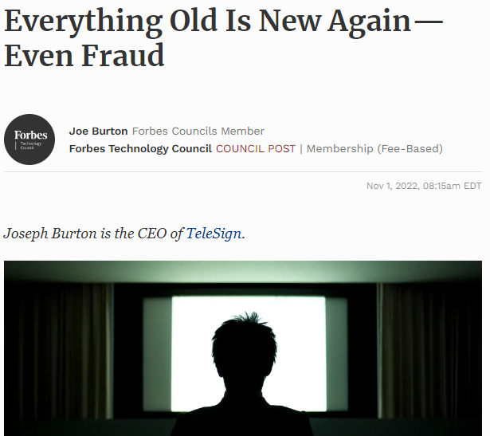
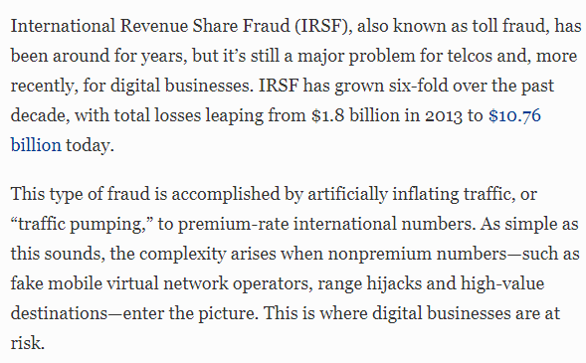
Are the security threats for real?
“IRSF has grown six-fold over the past decade, with total losses leaping from $1.8 billion in 2013 to $10.76 billion today.”
Everything old is new again – even fraud
https://www.forbes.com/sites/forbestechcouncil/2022/11/01/everything-old-is-new-again-even-fraud/?sh=3a0272b2126d

Slide 10
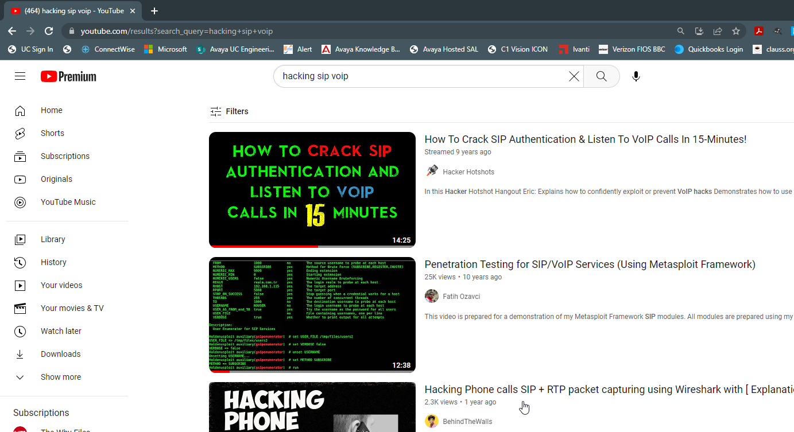
Are the security threats for real?

Slide 11
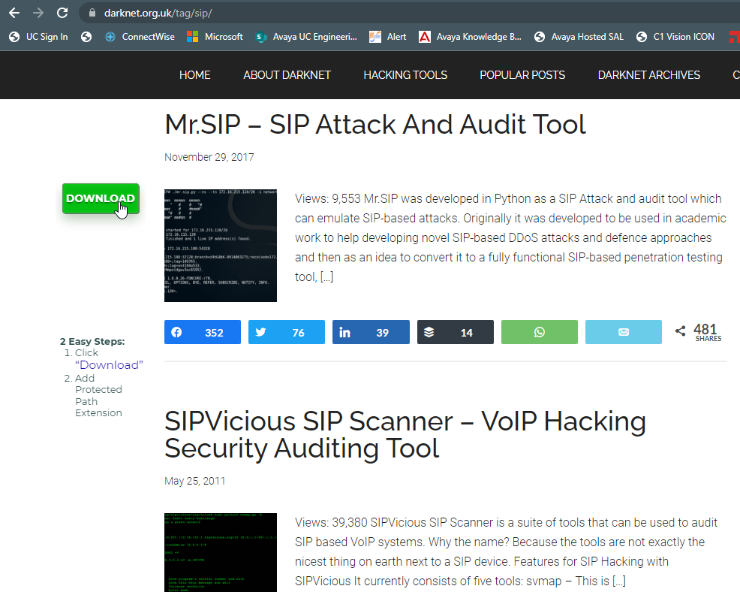
Are the security threats for real?
Tools are easily found online
https://www.darknet.org.uk/tag/sip/

Slide 12



Confidentiality Attacks – is someone listening in?
Eavesdropping signaling –
Who calls whom and when?
Eavesdropping media –
Obtaining voice, fax, video, data.
Remote software exploits –
Theft of confidential data.
Earnings for the year are…
Notes:
Notes
Confidentiality or privacy of communications and data are the highest priority for security.
Interception attacks include:
Eavesdropping on the media stream (the communications payload)—for example, an attacker listening in on the conversation
Eavesdropping reconnaissance on signaling traffic to determine who is calling whom, at what numbers, and when
Attacking a VoIP endpoint, gaining control, and stealing confidential business data

Slide 13
Availability Attacks – Denial of Service
Denial of Service (DoS) and Distributed Denial of Service (DDoS) floods – network layer, SIP layer.
Fuzzing applications that
send malformed SIP or
RTP to test for security vulnerabilities or crash the voice system.
Stealth DoS such as harassment (phone rings every 5 minutes)
Are you there?
Notes:
Notes
Fuzzing is a software testing technique used to discover coding errors and security loopholes in software, operating systems or networks by inputting massive amounts of random data, called fuzz, to the system in an attempt to make it crash.
Voice and data communications are business-critical resources. Some traditional phone systems have a 100+-year track record of near-total Availability; that is, whenever you lifted the receiver, you always had dial tone and could make calls. There might have been times when the system was not available, but if you did not need the system at that moment, then the system is considered “available.”
Any attack that ties up VoIP resources, making the system unavailable even for seconds, are attacks against Availability.
DoS and DDoS attacks are typically executed by one or more people who interrupt or suspend services of a host by flooding it with communication requests, so that its resources are consumed and it cannot provided the intended service.
A flood of information and/or requests to a single network adapter affects every computer in the network.
Many creative fuzzing techniques are able to uncover security vulnerabilities that make Denial of Service attacks possible.
Stealth attacks are essentially lower-frequency DoS attacks, for example, your phone rings every 5 minutes. Although this is not your traditional DoS attack that brings down the entire system, it is extremely annoying and can impact your ability to work.

Slide 14
Security Attacks - Authentication (e.g. Toll Fraud)
Unauthorized toll calls placed by internal or external users.
Intercepting dial patterns to retrieve access codes.
Using SIP methods
to transfer sessions.
Is that you Bob?
Notes:
Notes
Toll Fraud can occur in traditional TDM and IP systems.
“Toll” means a call that is made to a destination beyond the local calling area (LATA) and which is charged (usually on a per-minute basis) above the local or flat rate to the calling party.
If hackers intercept or redirect the dial patterns and feature access codes, then they are free to place unauthorized calls.

Slide 15
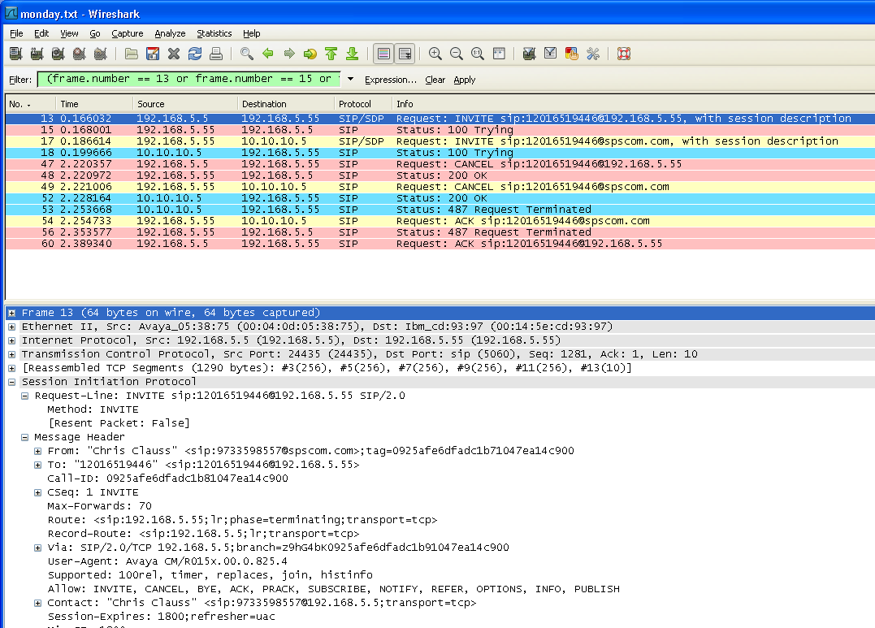

VOIP Trace – What’s the problem with this picture?

Slide 16

We need to protect voice call and signalling
We can protect voice calls using encryption.
TLS based encryption of SIP and h.323 signaling
Secure RTP (SRTP) of the media path.

Slide 17
We use encryption to protect data.
Lock data – unlock with a key
The sender encrypts the data with a key.
The receiver uses the key to unlock the data.
This is symmetric encryption – both sides use the same key.
Problem is key distribution. How can we share the keys in a secure fashion?

Slide 18
We use encryption to protect data.
Public Key Encryption
Sender
Instead of sending a key, we send a lock. Only the recipient has the key to unlock the data.
Based on mathematic formulas that create a key pair. One private and one public.
Data encrypted with one key can be decrypted with another.
Send uses public key to encrypt data, receiver uses private key to decrypt.
Public Key
Private Key
Recipient

Slide 19
Encryption provides confidentiality, but does not provide authentication.
To provide authentication, the sender can “sign” the data with their own private key. This is the senders certificate.
The receiver can decrypt the signature using the sender’s public key.
Problem remains, how can we be sure the sender is who they say they are?
Chris
Chris

Slide 20
So, what is a Certificate Authority
A trusted source of Certificates.
This can be a public company such as GoDaddy / GlobalSign / SSL.COM
It can be a private service your company hosts using software such as Microsoft Active Directory Certificate Services or Java Certificate Authority (EJBCA)
In an Avaya Aura Solution, System Manager can be used as a certificate authority. SMGR leverages EJBCA
The certificate authority is responsible for issuing certificates. If you trust the certificate authority, your trust the certificates.

Slide 21

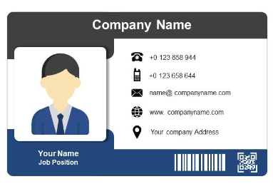
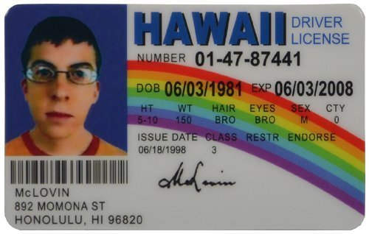
A simple example of certificate issued by some authorities. Would you trust…?
Certificate trusted universally because we trust the US Government to issue valid passports with security features to prevent counterfeiting.
Trusted withing an organization. May or may not be trusted outside unless there is a relationship.
Would you trust this “certificate”? Why or why not?

Slide 22
Use a certificate authority to certify the identity of the sender…
The sender sends a copy of the certificate to a certificate authority (CA).
The certificate authority signs the senders certificate, and establishes a chain of trust.
Since we trust the CA, and the sender’s data was signed by a certificate trusted by the CA, we trust the data.
This is the “chain of trust”.
Chris
Chris
TRUST
Certificate
Authority

Slide 23
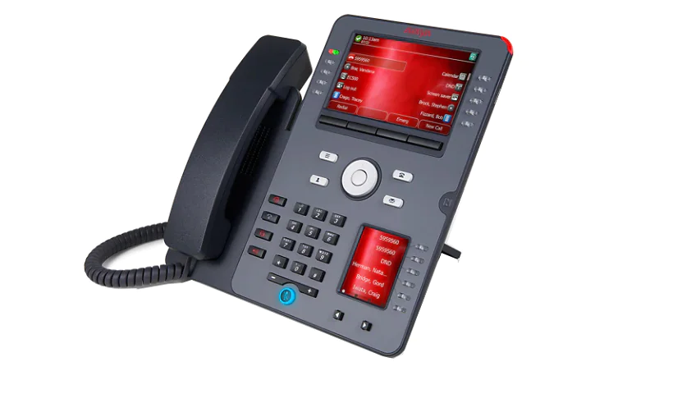
In an Avaya Infrastructure System Manager can be the “CA”
System Manager can serve as the certificate authority for Avaya servers.
System Manager provides signed certificates for Session Manager, CM, SBC, etc.
Customers can use a public CA. In this case System Manager becomes a subordinate CA.
Chris
Chris
TRUST
System
Manager C/A

Slide 24
Three types of Certificates
Root / Trusted Certificates (and also intermediate certs).
Certificate that validates the Certificate Authority itself (GoDaddy / System Manager). A root certificate is self signed, and keys are very secure.
Server / Identity Certificates
Signed by a Root Certificate Authority
Systems will trust the server / identity certificate if the system trusts the root.
Self Signed Certificate
A certificate created by a server itself. Any other server that needs to trust this machine must also install this self signed cert in the server’s trust store.

Slide 25

How to get Certificates for a server?
Certificates can be requested from a certificate authority two ways. Recall that for public key encryption, two keys are needed – a private key and a public key.
Create a certificate signing request. This will create our keys and creates and unsigned certificate in a request. This request is sent to the CA to be signed. We can now install this signed certificate to be used by the server.
Have the CA create the keys and certificate. This will generate a password protected file with the two keys and a signed certificate that can be installed an used by the server.

Slide 26
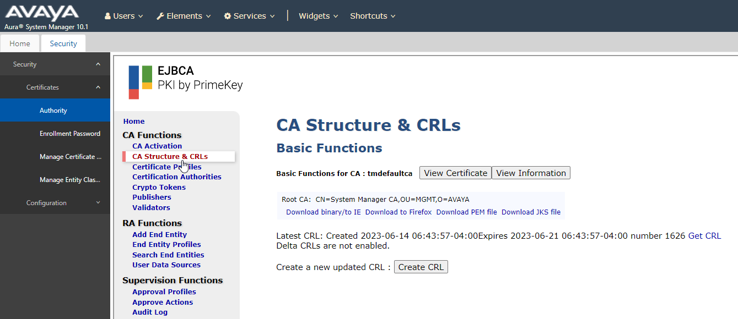
System Manager Certificate Authority

Slide 27
System Manager Certificate Authority – Viewing / Download Root

Slide 28
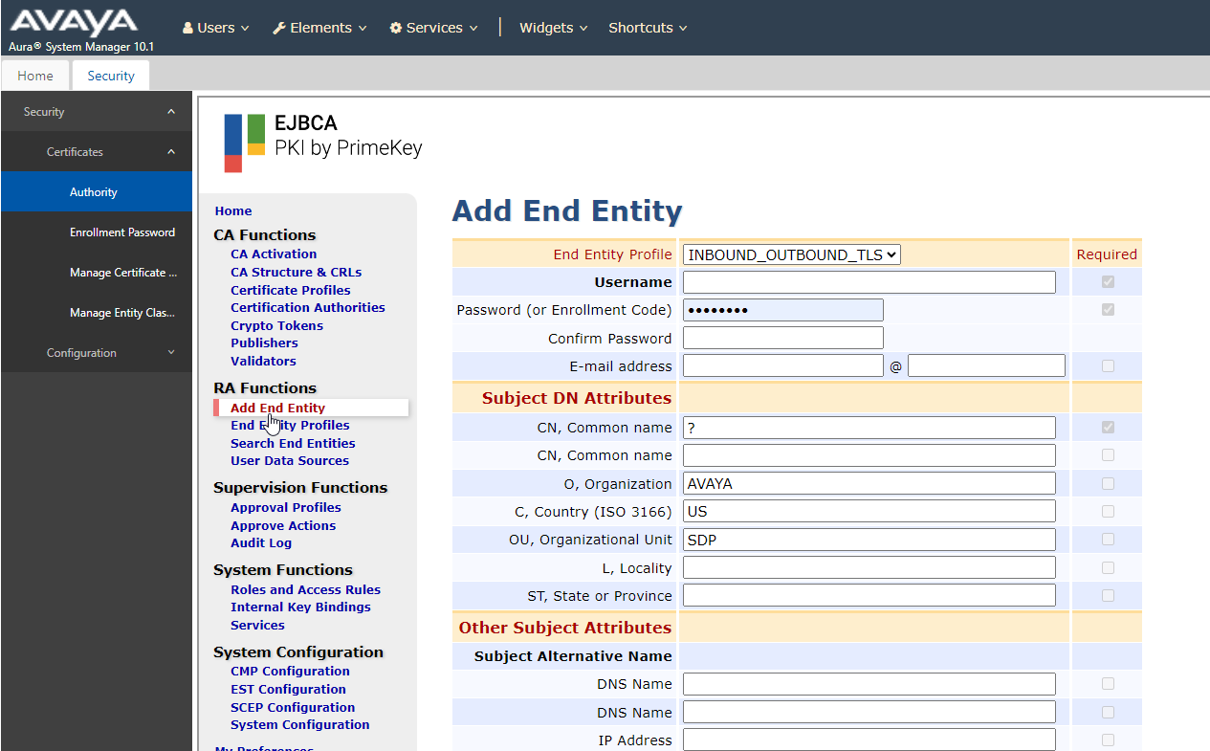
System Manager Certificate Authority – Registration Authority (RA) Functions – Registers info for a certificate

Slide 29
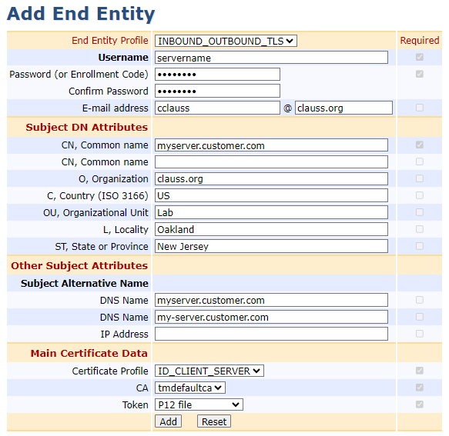
System Manager Certificate Authority – RA Functions – Create or Sign Identity Certs for Servers
Username – use the server name
Password – your choice – remember it
eMail – options
Common Name – server DNS name
Organization / Country / Unit / Locality / State are all optional. Informational
Subject Alternative Name – very important.
Specify the DNS name of the server.
Add a secondary name if needed.
Do not add IP address – bad practice.
SAN is enforced by Apple and Google since 2018.
Select the Token Type

Slide 30
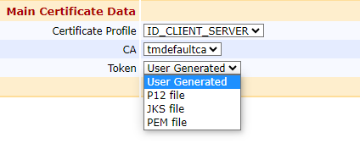
System Manager Certificate Authority – RA Functions – Create or Sign Identity Certs for Servers
Main Certificate Data
Certificate used for Client / Server interactions
CA – the CA that is signing your certificate. By default that is “tmdefaultca” which is the default name of the System Manager
Type of “token” to be generated
  P12 file – the SMGR will create a password protected certificate for the server including keys
  PEM file – the SMGR will create a simple certificate file but requires a certificate signing request from the server
Click Add when done

Slide 31

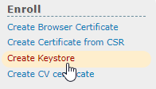
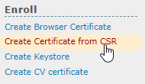
We added a registration, and now need to create a certificate.
Select Public Web
To generate a new cert with keys, select the option to Create a Keystore.
To generate a new cert in response to a signing request, select Create Certificate from CSR.

Slide 32
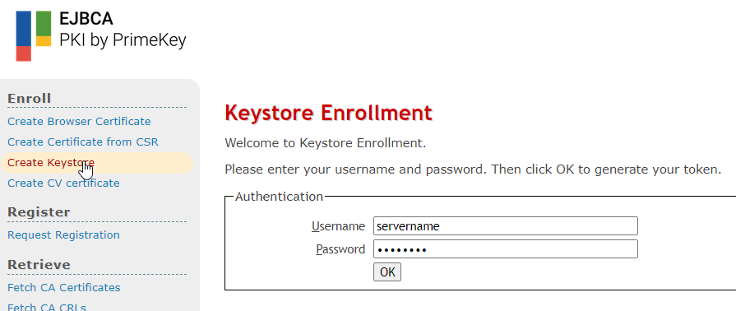
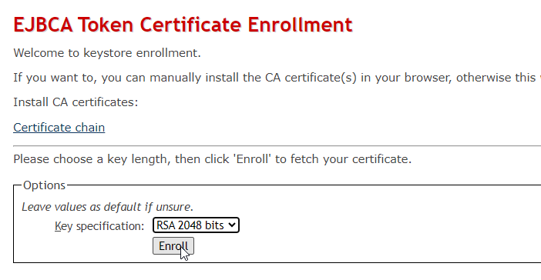
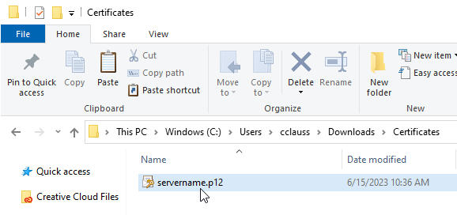
Creating the certificate for the registered earlier…

Slide 33
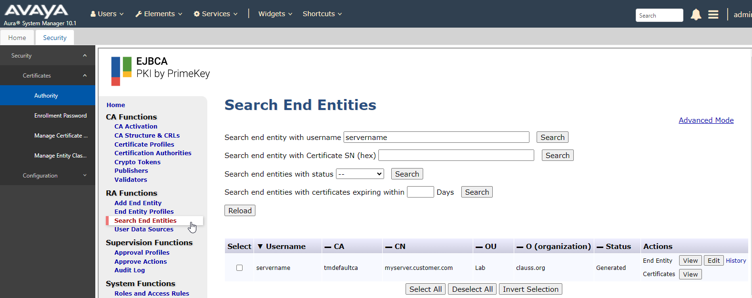
Viewing the Certificate in System Manager

Slide 34
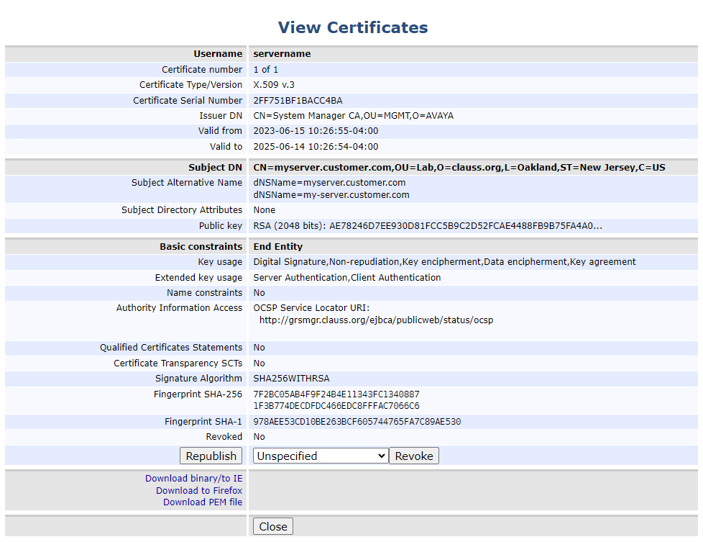
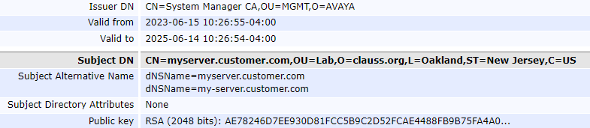
Viewing the Certificate in System Manager

Slide 35
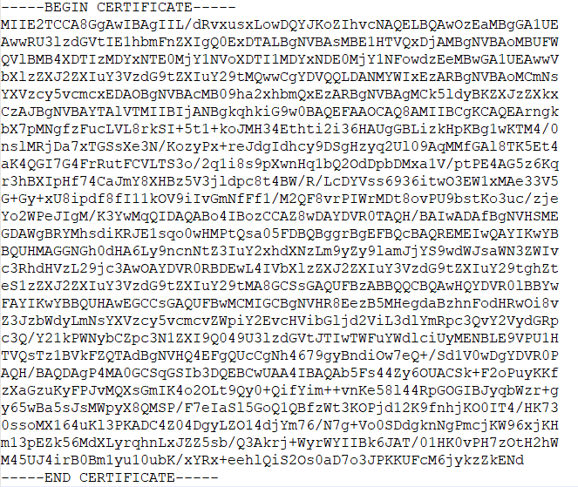
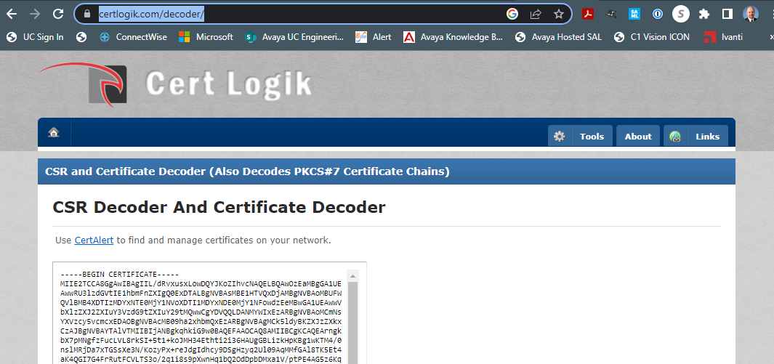
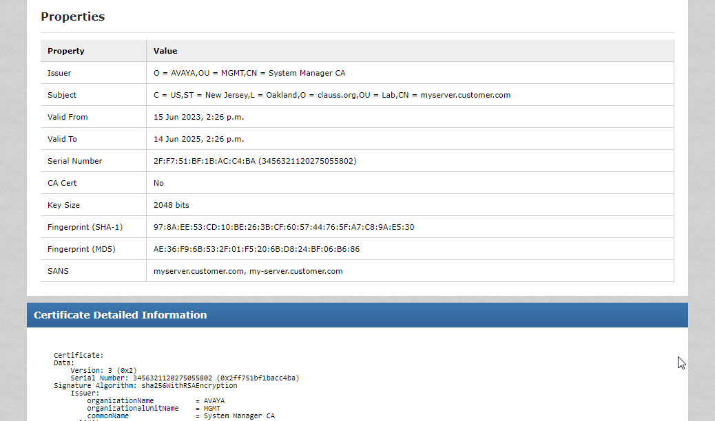
Looking at a certificate file – copy and paste your cert to an online decoder…
https://certlogik.com/decoder/

Slide 36

Nothing lasts forever – certificates expire…
When certificates expire, they must be replaced, just like a driver’s license or a passport.
It is important to know when certs expire.
Avaya devices send alarms indicating that certificates will expire within a give number of days.

Slide 37
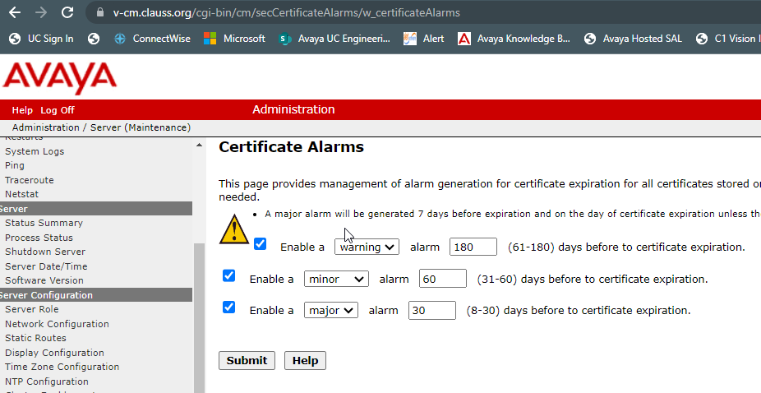
Nothing lasts forever – certificates expire…
Avaya devices send alarms indicating that certificates will expire within a give number of days. When certs expire, things stop working.

Slide 38
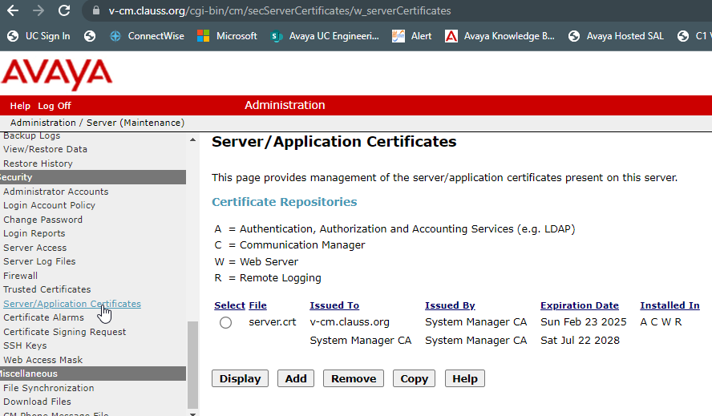
How can I find out when my certificates expire?
Look at the certificate. Certs can be viewed on the servers they are installed on.
Each product is different.

Slide 39
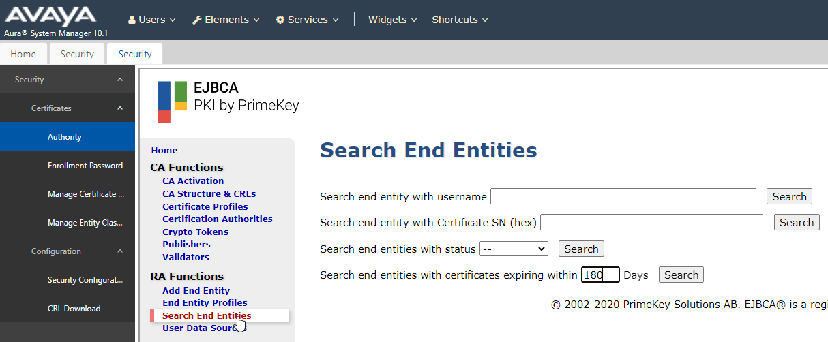
How can I find out when my certificates expire? The best way…
Look at your certificate authority for a list of all the certs that were generated and filter on expiration…

Slide 40
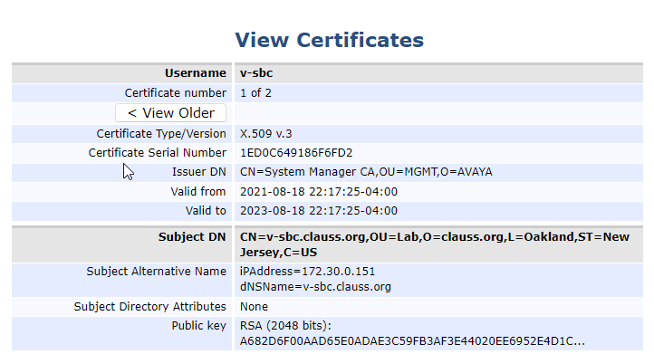
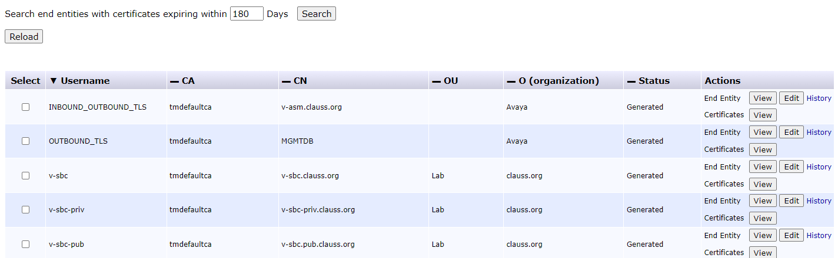
How can I find out when my certificates expire? The best way…
Look at your certificate authority for a list of all the certs that were generated and filter on expiration…
Yikes!
Better fix this!

Slide 41

System Manager can auto renew certain certificates…
System Manager automatically renews certificates for systems in the following cases…
System Manager is the CA that issued the certificates for the specific system.
The system is managed by System Manager
  Session Manager
  Breeze
Also, for some servers, there is an enrollment process to make renewals easier
  Media Server
  Avaya Aura Device Services / Web Gateway

Slide 42

So what should we use for our Certificate Authority
Several options…
Check with internal security team on specific company mandates.
Use System Manager as CA for Avaya server to server communications (ease of admin and secure)
Use Public CA for end user facing systems (SBC remote worker / web)
Use internal CA if required.

Slide 43
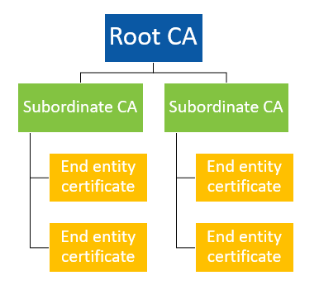
Summary of ca hierarchy
Root CA may be System Manager or customer CA
Intermediate CA may or may not be used
Each end entity will have a unique identity certificate signed by the CA.
Each end entity must have root or intermediate certificates installed.

Slide 44
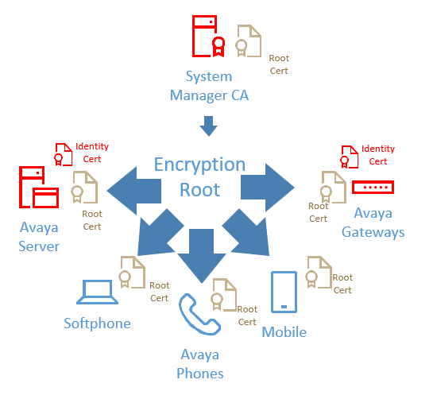
System Manager as the Certificate Authority

Slide 45

System Manager as the Certificate Authority
Pros
Works out of box
Automatically issues and deploys and redeploys certificates for managed elements (SMGR / SM) Aura environment stands alone
Simplest - Easy to manage by customer & partners
Cons
PKI is independent of other PKI
No enterprise branding
Must distribute PKI to endpoints
SECURITY

Slide 46
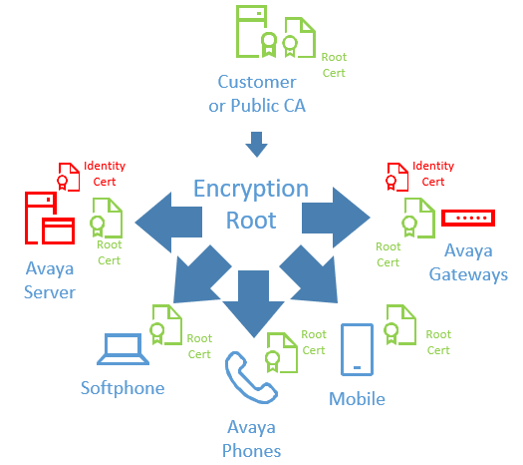
Enterprise Certificate Authority

Slide 47
Enterprise Certificate Authority
Pros
Provide enterprise asserted trust
Certificates may already be distributed to client devices.
Cons
Must manually establish PKI trust chain to Aura managed devices.
Must create Certificate signing request and import identity certificates
No automatic issue or re-issue of certificates.
Involve IT for all certificates needed
Relatively straightforward deployment. Not require for all devices. (Can generate identity certs only for required)
SECURITY

Slide 48
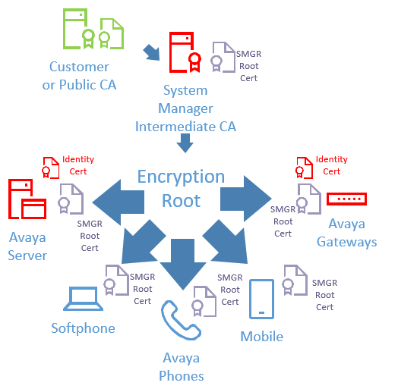
System Manager as a Subordinate CA

Slide 49
System Manager as a Subordinate CA
Pros
Provides enterprise certs.
Certificates may already be distributed to client devices.
Automatically issues and deploys and redeploys certificates for managed elements (SMGR / SM)
Cons
Enterprise must allow sub-CA
Trust chain must be distributed to all Aura elements
Difficult to implement but allows for a chain of trust to internal I/T. Usually not well received by I/T.
SECURITY

Slide 50
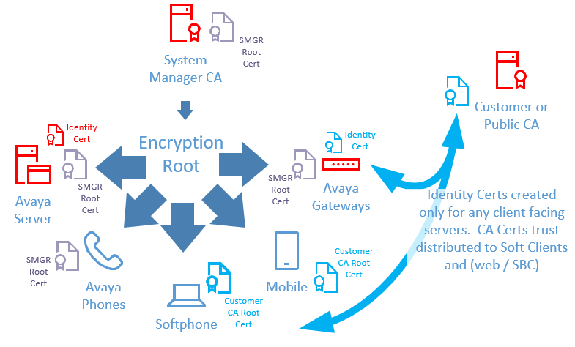
SMGR for Aura / Public CA where needed

Slide 51
SMGR for Aura / Public CA where needed
Pros
Provides enterprise certs where needed.
Allows SMGR to provide certs for Aura
Certificates may already be distributed to client devices.
Automatically issues and deploys and redeploys certificates for managed elements (SMGR / SM)
Aura managed certs for most “internal” servers.
Cons
Two PKI authorities
SECURITY

Slide 52
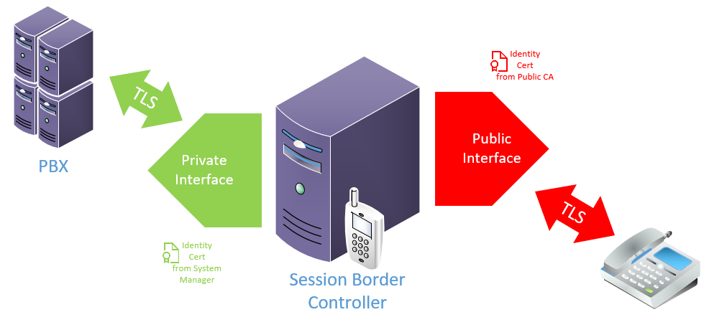
Examples of TLS links used by SBC – different certs signed by different CAs

Slide 53

Questions / Comments / Applause / Boos…

Slide 54

What’s the best way for you to get help with security and certificates?
Find the best partner – here at the show!
Please fill out your session survey! Session 1088
Please tweet about the presentation if you liked it - @clauss
Come ask us questions
Call us – 888-777-7280
Check us out online – www.convergeone.com
Thanks for attending!
Chris Clauss
cclauss@convergeone.com

