Slide 1

Password Management and SSO/SAML for Remote Workers, Avaya Sets, and Soft Clients

Slide 2



Chris Clauss
Manager, Avaya UC Engineering
Collaboration - ConvergeOne
David Lover
VP Strategy and Technology
ConvergeOne

Slide 3

Feel The Impact
ConvergeOne
Notes:
ConvergeOne is an IP Enabled, services led technology company which provides a holistic environment for secure connected customer experiences for our clients.

Slide 4
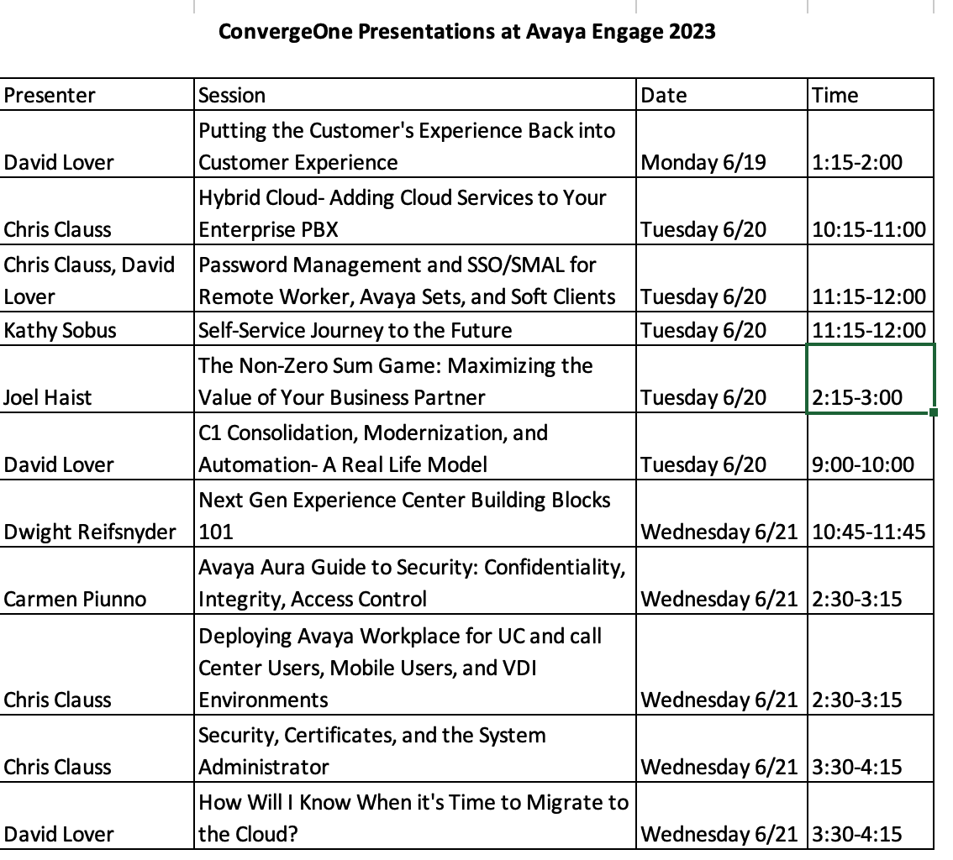

Visit our Other Sessions!

Slide 5
Communications Trends
  User-Centricity (As opposed to Device Centricity)
    No longer a digital set where the port defines the identity of the device - An IP Phone user now needs to log into their phone or soft phone to assign identity.
  Mobility
    Accessible anywhere, outside of secure enterprise network
    SBCs enable app to server security using just username and password

Slide 6
Your Communications Environment is not Secure by Default
  SIPVicious is a family of tools that are used to test the vulnerability of SIP based servers
  Your internal employees know your password scheme
  Your ex-employees know your password scheme
  You have no policy and enforcement mechanism – without a lot of manual effort and cost

Slide 7
SIPVicious
  SIPVicious is a family of tools that are used to test the vulnerability of SIP based servers.
    svmap - this is a SIP scanner. Lists SIP devices found on an IP range
    svwar - identifies active extensions on a PBX
    svcrack - an online password cracker for SIP PBX
    svreport - manages sessions and exports reports to various formats
    svcrash - attempts to stop unauthorized svwar and svcrack scans

Slide 8
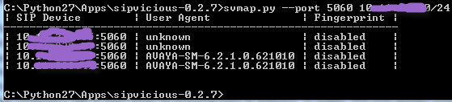
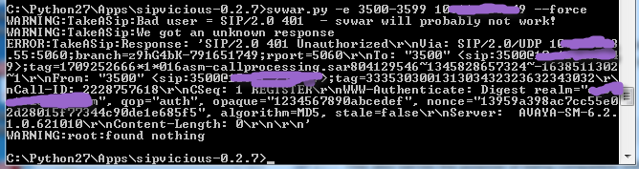
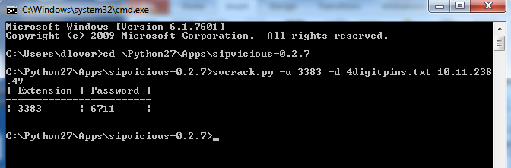
Station PINs

Slide 9
Station PINs
  A typical PC can do about 70 registration / second
    4-digit pin (0000-9999) can be hacked in 142 seconds
    5-digit pin (00000-99999) can be hacked in 23.8 minutes
    6-digit pin (000000-999999 can be hacked in 3.9 hours
    7-digit pin (0000000-9999999) can be hacked in 1.6 days
    8-digit pin (00000000-99999999) can be hacked in 2.4 weeks

Slide 10
Steps to secure user accounts
  Start with an appropriately long and/or complex password that is difficult to guess or brute force hack.
  Change passwords frequently
  Turn on Firewalls that contain “rate limiting” to slow down a hacker’s brute force speed.
Note: PCI Data Security Standard 4.0 - Password Requirements
12 Characters (containing both numbers and letters)
Ensure the last 4 passwords cannot be re-used
Requires Passwords to be changed every 90 days

Slide 11

What is or will be driving security in your organization?
Devices
  Remote Worker
  Internet Connected Device
  BYOD
  Hosted Solutions
Security Teams
  Are they asking for audits?
  Are they taking notice of U/C?
  Is management worried (news)?
What needs to be secured?
  Voice conversations
  The systems themselves

Slide 12
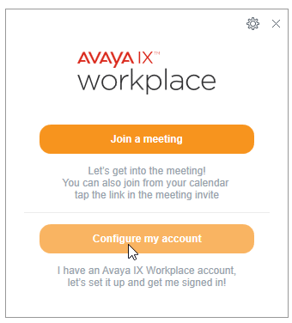
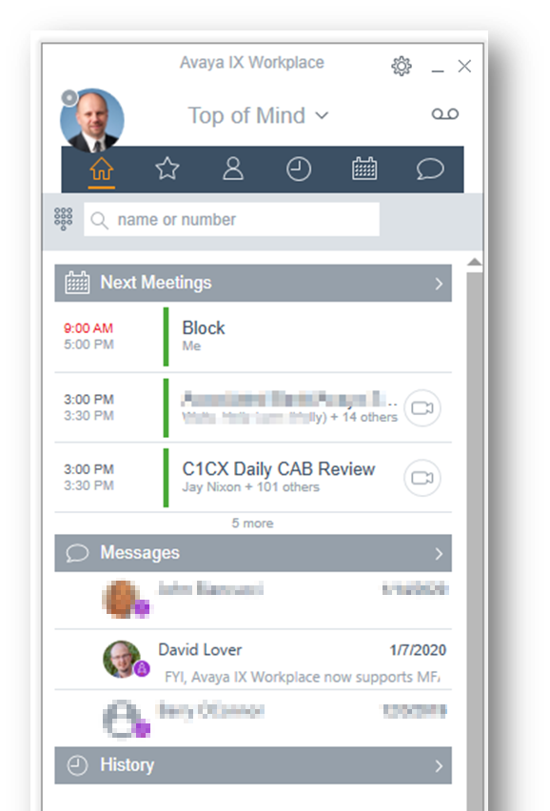
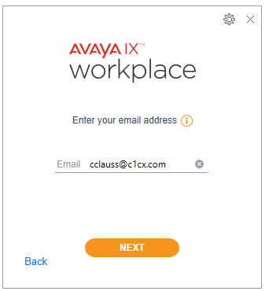
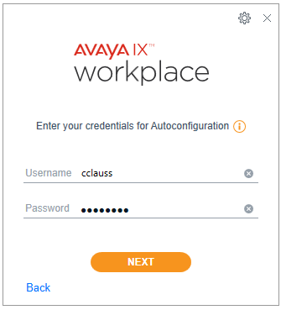
End user login / ease of configuration

Slide 13

What you don’t didn’t about logins…
Really Important!
A phone or soft client always uses SIP station login and SIP station password to connect to Session Manager or SBC.
An attacker can use this information to login a station, even if you are using other authentication techniques.
The best way to protect against this – leverage the tools Avaya and C1 provide so that SIP station passwords can be impossible to guess.
Never give a user a station password. Use single sign on.

Slide 14
Avaya Aura Device Services to the rescue!
Device services provides…
Single Sign on Support using LDAP or SAML
Dynamic Configuration of workplace clients, Agent for Desktop, and physical sets, matching users to customer LDAP and A/D groups to define features.
Provides enterprise directory services to soft clients.
Administrators manage user configurations across the enterprise from a single pain of glass.
Synchronization of users between enterprise and Avaya Cloud services – Spaces.

Slide 15
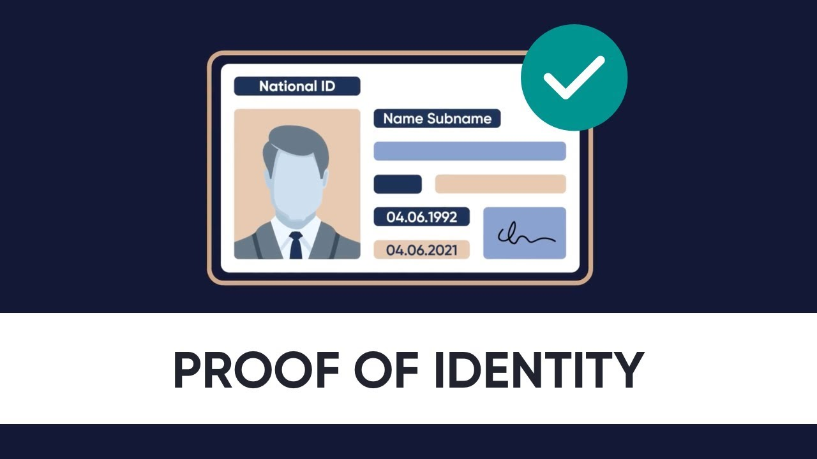
Authentication
Who do we authenticate to?
LDAP providers (generally MS Active Directory)
Lightweight Directory Access Protocol
SAML providers (MS Azure / ADFD / Okta / etc.)
Security Assertion Markup Language

Slide 16
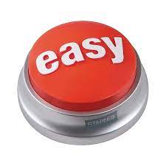
LDAP Authentication
Pros / Cons
LDAP is great for on-prem authentication.
Simple query against LDAP to validate login.
Very easy to implement with compatibility across many applications.
Applications pass logins / passwords to LDAP for authentication.
Problem – the application knows the login / password?!?

Slide 17
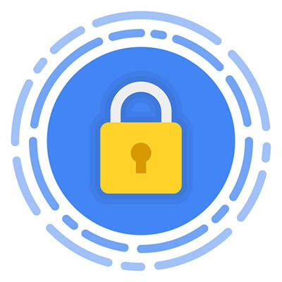
SAML Authentication
Pros / Cons
Designed for cloud.
Logins are redirected to a trusted SAML identity provider via an external app (usually a web browser).
Application never knows login / password.
Provider sends a token back to application. The token indicates if login was successful and how long it is valid.
Implies that trust must be configured between the application and the identity provider. Difficult to implement?!?

Slide 18
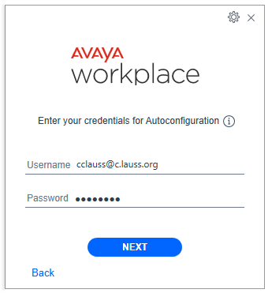
LDAP Authentication on Workplace Client
Login and password entered in the application itself.
Credentials are passed to AADS securely and AADS proxies a login to LDAP server to validate the login / password.
AADS matches that user to System Manager and pulls the station login and password.
AADS sends that information back to workplace to login the user.

Slide 19
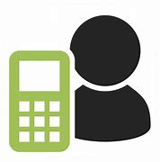

Single Sign On - LDAP
User wishes to login to phone
AADS gets password.
AADS Validates login with LDAP
AADS matches user email to SMGR
SIP station login sent back to AADS
AADS builds config based on group membership and sends SIP login back to user to login
User enters login / password into app.
Sends info to AADS
AADS pulls email / groups

Slide 20
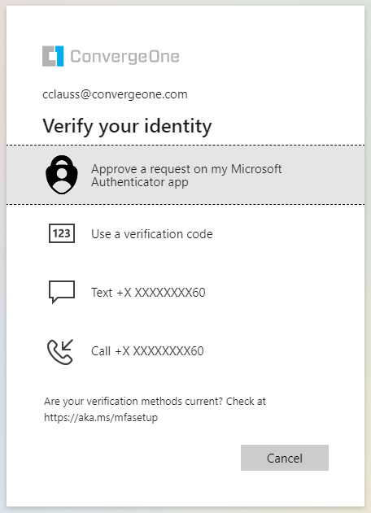
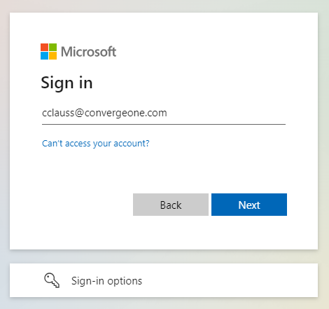
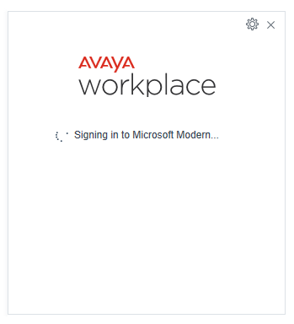
SAML Authentication on Workplace Client
A web screen is popped on the device to have the user authenticate to the identity provider.
Once complete, the provider sends back a token with the user’s information.
AADS matches that user to System Manager and pulls the station login and password.
AADS sends that information back to workplace to login the user.

Slide 21
Single Sign On - SAML
Login
Password
User wishes to login to phone
AADS tells phone to use SAML
Phone / App pops
browser
User enters login to browser. not the app
SAML validates login.
Sends token to AAD
AADS receives token and pulls email address*
Phone / App asks AADS to login

Slide 22
Single Sign On – SAML - Continued
SAML validates login.
Sends token to AAD
AADS receives token and pulls email address*
AADS matches user email to SMGR
SIP station login sent back to AADS
AADS matches user with LDAP server to get group membership
LDAP groups information looked up by AADS
AADS builds config based on group membership and sends SIP login back to user to login

Slide 23
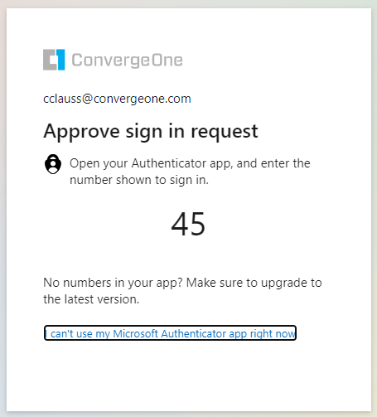
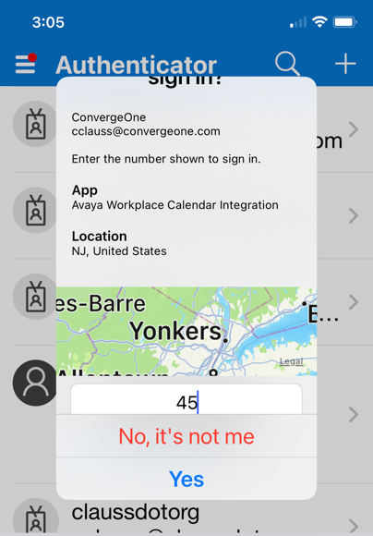
SAML Easily supports MFA (Multi Factor Authentication)
Extends security beyond password.
Something you know…
Your Login and Password
Something you have
A cell phone app or token ID card
Something you are
Face recognition on a cell phone
Successful login will send a token to AADS to validate the login.

Slide 24
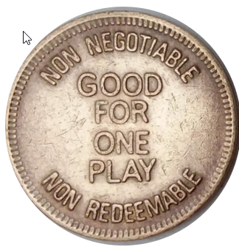
What is a SAML token?
Contains information the software can use.
Token will return information we can use to allow the application to work.
Name of the user
Groups / Permissions
Some type of “matching” field – usually email address.
  Match a user from SAML to a user in Avaya systems.
Has an expiry time – user must reauthenticate.

Slide 25
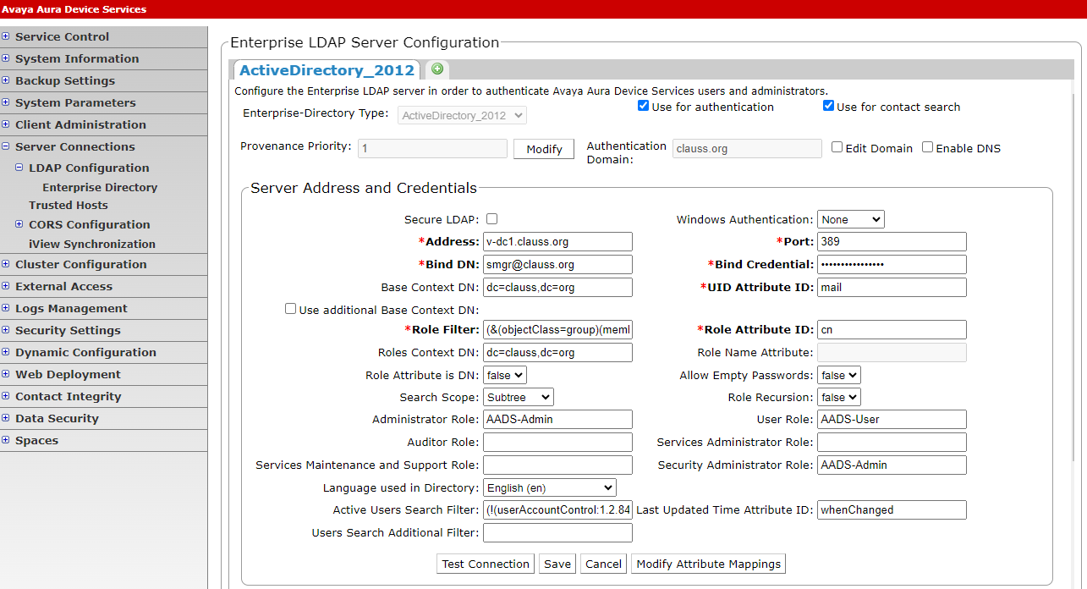
AADS LDAP Authentication

Slide 26
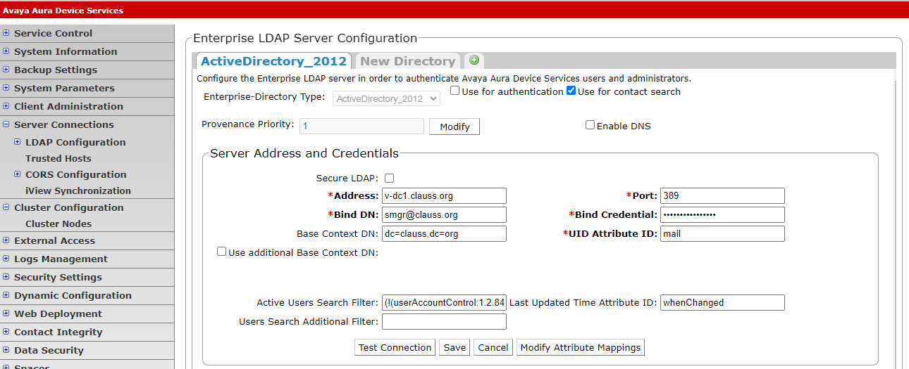
AADS SAML Authentication

Slide 27
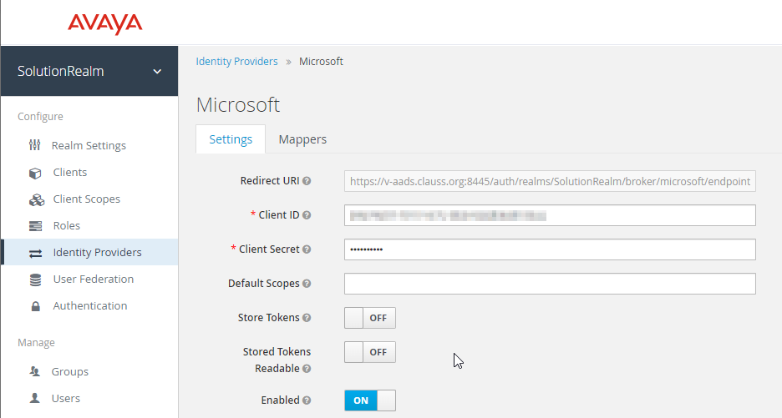
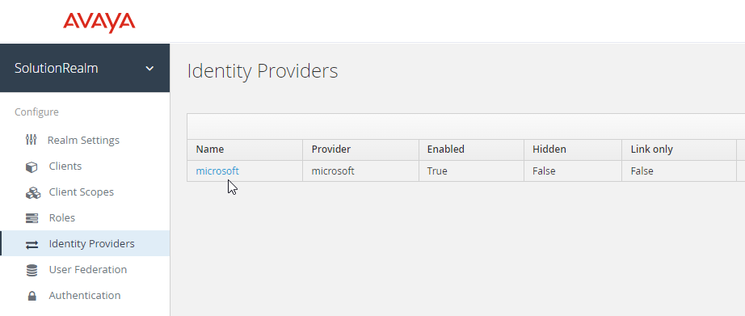
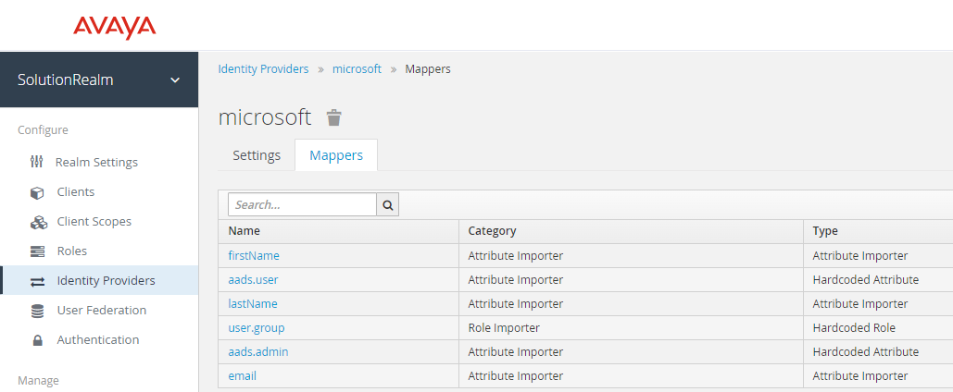
AADS SAML Authentication

Slide 28
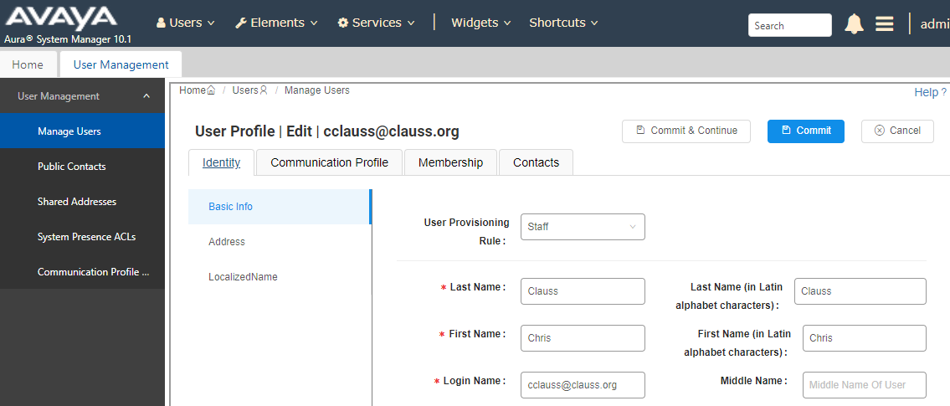
Now that a user is authenticated?
How do we get the settings for a station?
Once LDAP or SAML authentication has been completed, we get a matching field.
AADS matches that to a System Manager user profile (usually by email address)
Once we know what Avaya user we need to login, we can pull the SIP username and password.

Slide 29
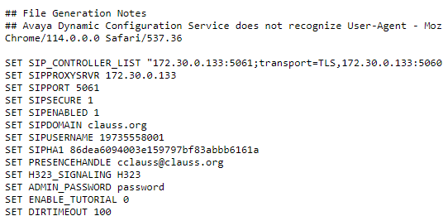
AADS uses this information to build a config…
AADS grabs the SIP login, encrypts it, checks the group memberships, then builds a custom config (46xxsettings) file and sends it to the endpoint.

Slide 30
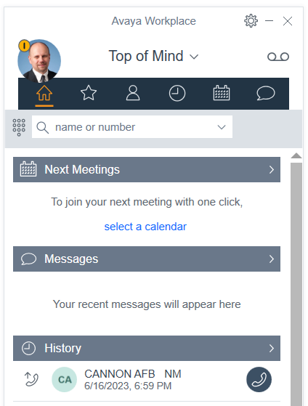
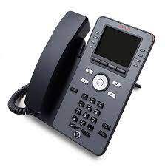
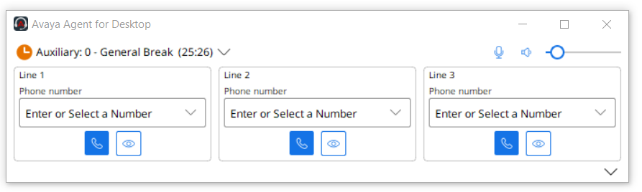
What clients are supported by AADS?
AADS send the config to the endpoint with SIP login
Avaya Workplace
Avaya Workplace (Call Center)
Agent for Desktop
J1XX physical endpoints

Slide 31
What about support for physical phones?
J100 Series sets support SSO staring in 2023
AADS is required
Requires AADS 10.1.1 and later
  SMGR / ASM 8.1.3 or 10.0
Latest SIP firmware 4.1.x (April 5, 2023)
  Supports TLS 1.3
Only supports Avaya IAM
(Identity and Access Management)
IAM can cascade logins to another Identity Provider
Future – direct authentication with another identity provider.

Slide 32
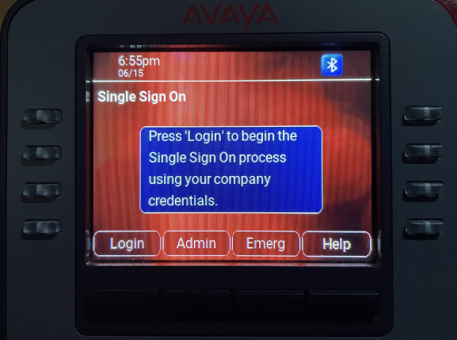
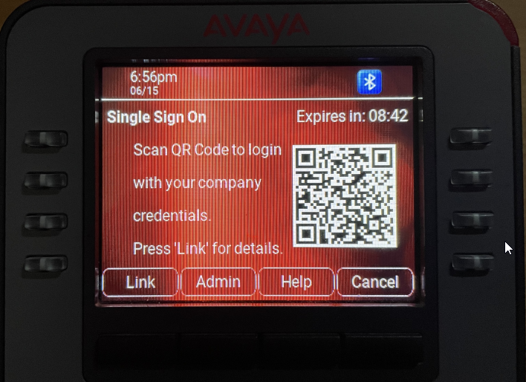
How do I type my password into a phone?

Slide 33
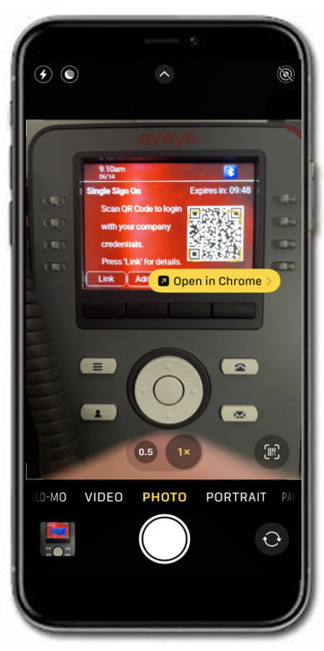

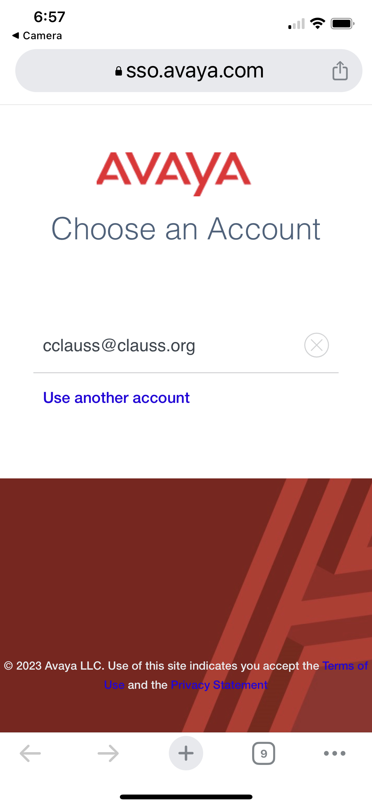
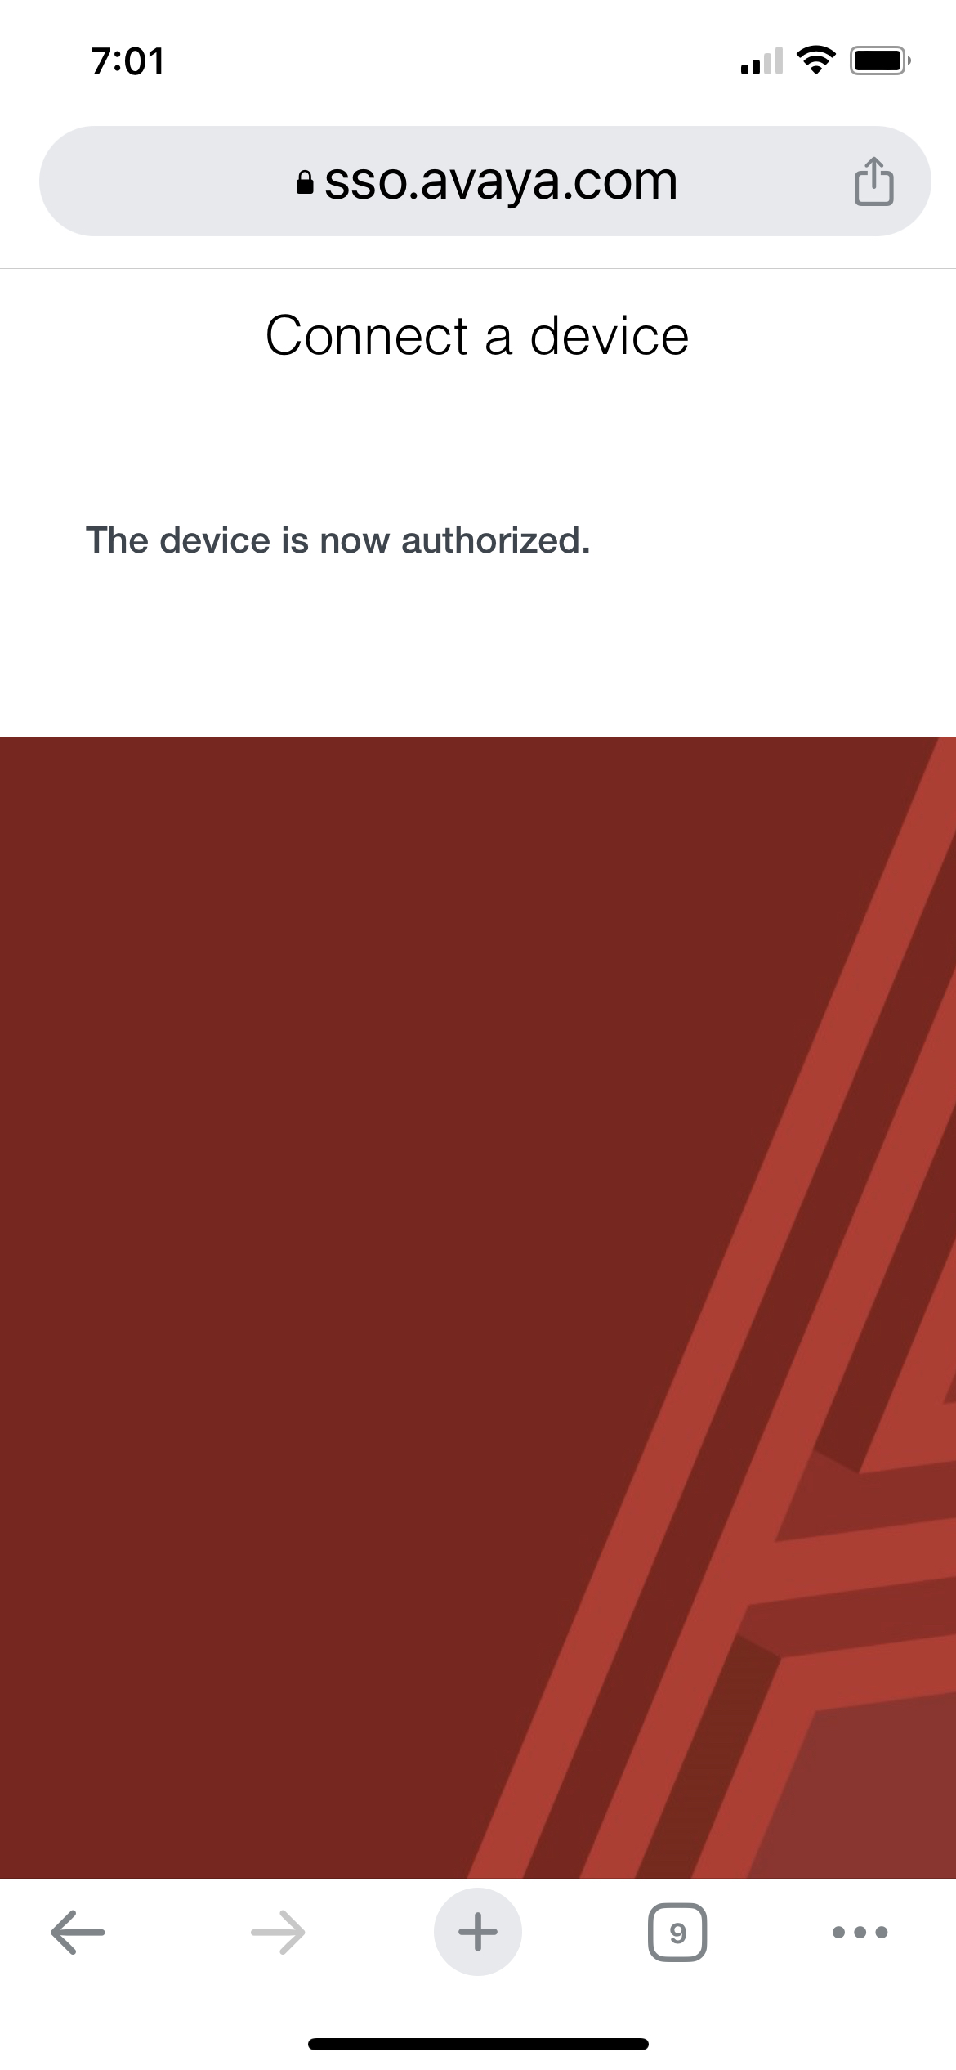

Slide 34
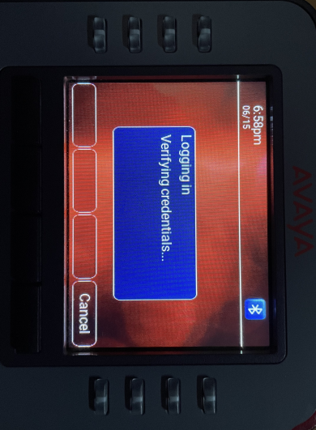
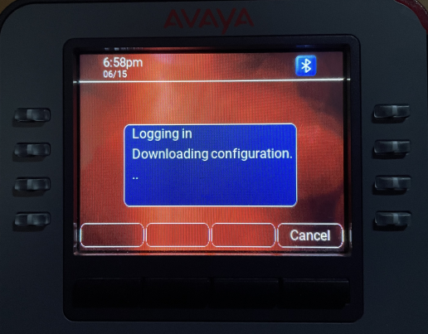
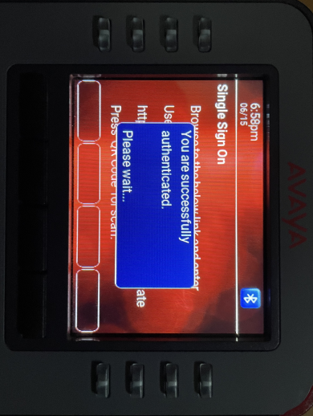
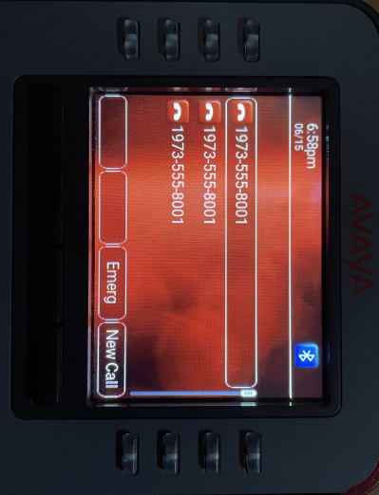
How do I type my login on a phone?

Slide 35
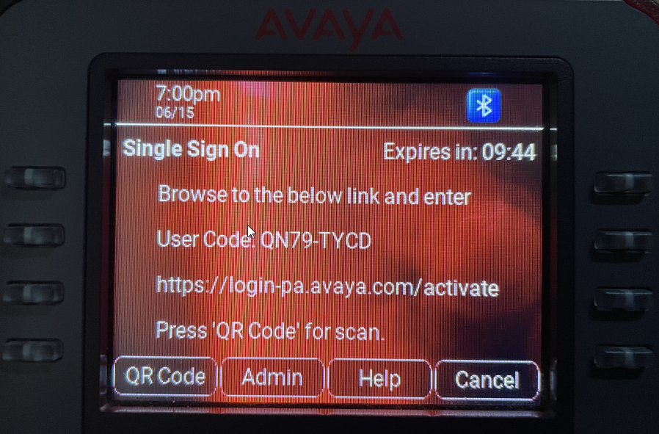

Slide 36
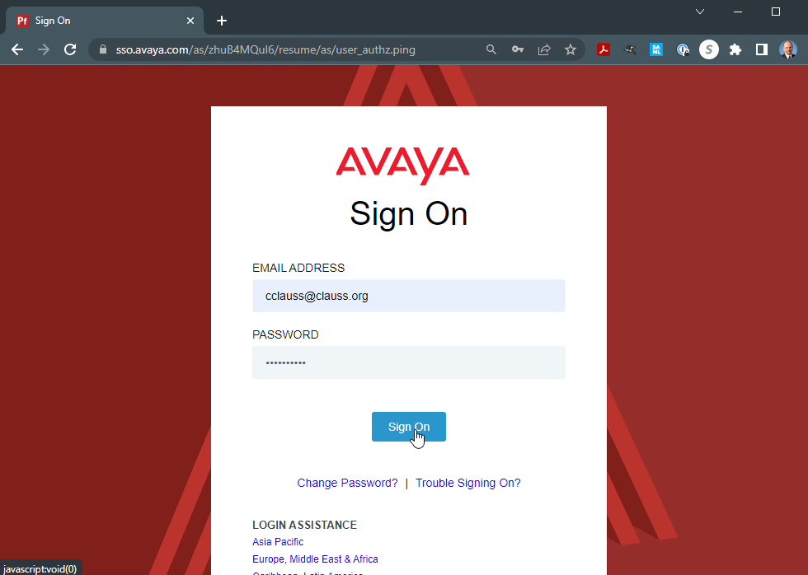

Slide 37
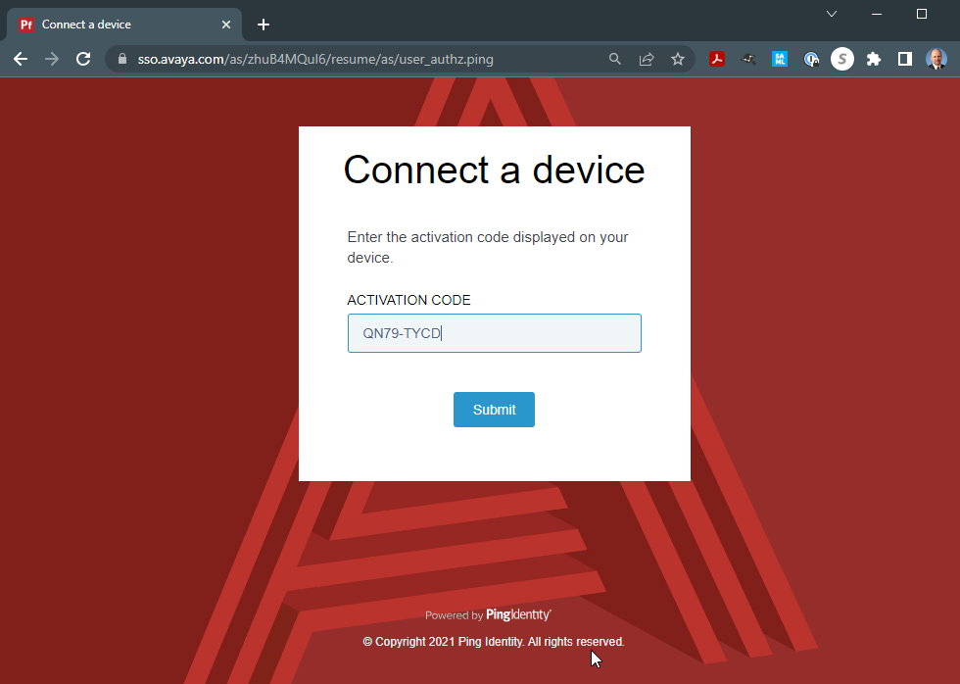

Slide 38
Configuring Set SSO…
Edit 46xxsettings.txt
Need 1 line…
SET AADS_URL https://aads.customer.com/acs/resources/configurations
All other settings will be pulled from AADS when the station login completes.

Slide 39
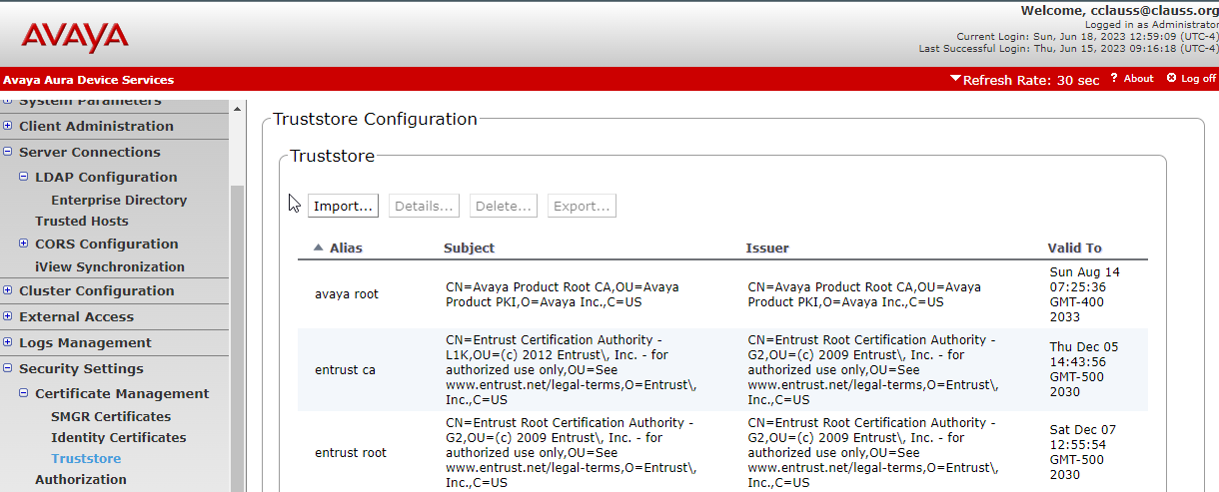
On AADS, several configuration items…
Add root certs for Avaya SSO to AADS Trust Store
Entrust Root Certificate Authority (G2)
Entrust Certificate Authority (L1K)

Slide 40
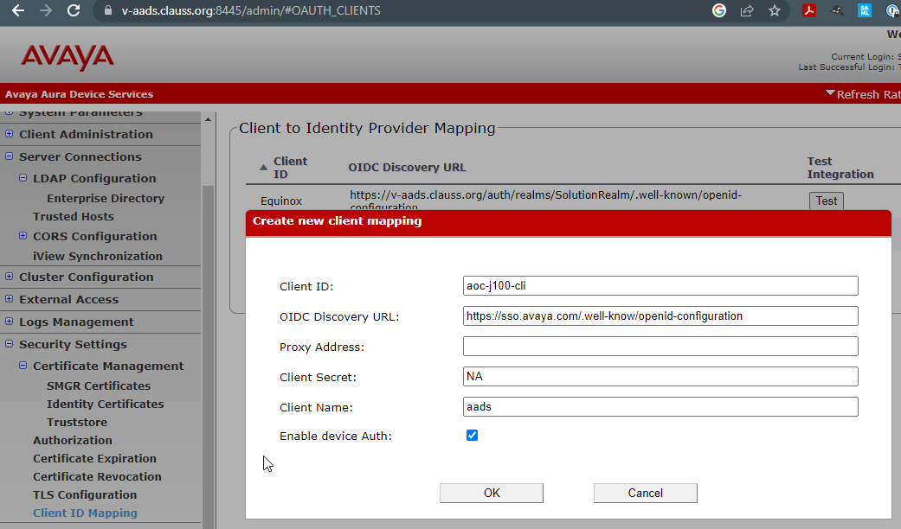
On AADS, several configuration items…
Add Client ID Mapping.
Add a proxy if needed.
Note – No SAML configuration needed on AADS

Slide 41
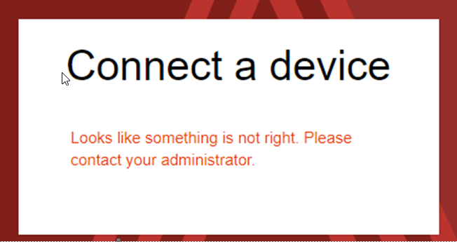
Last but not least… – test login…
If the login process works, but comes up with a something is not right error, open a case with Avaya to fix the
backend SSO to allow
your domain.

Slide 42
So back to password management…
Really Important!
A phone or soft client always uses SIP station login and SIP station password to connect to Session Manager or SBC.
An attacker can use this information to login a station, even if you are using other authentication techniques.
The best way to protect against this – leverage the tools Avaya and C1 provide so that SIP station passwords can be impossible to guess.
Never give a user a station password. Use single sign on.

Slide 43
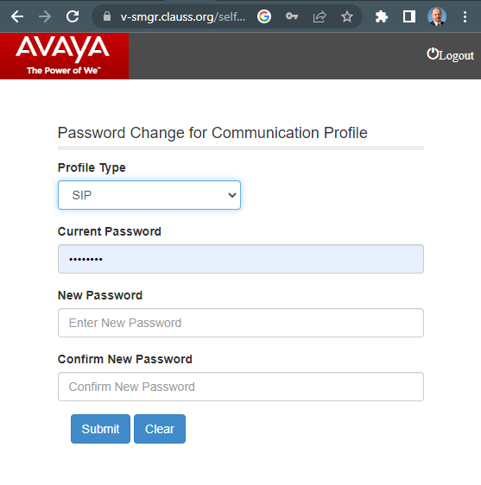
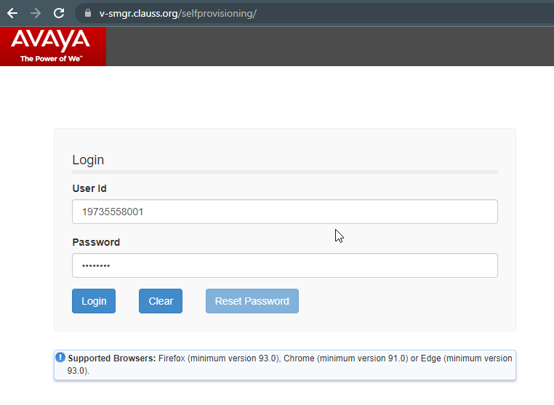
System Manager self provisioning tool https://smgr/selfprovisioning
Allows basic services for a user to change station login and password and reset passwords.

Slide 44
System Manager for password management
System Manager can provide user self service, but…
URL runs on System Manager
  Not good to place on public web
Has limited capabilities
Allows users to know their SIP station passwords
  Bad as they can be set to poor password
Problematic for single sign on integration.
Another solution….

Slide 45
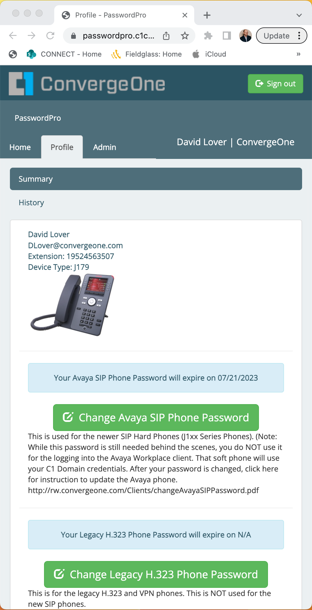
C1CX PasswordPro
  Simple and easy to use end-user portal
  Admin Dashboard provides at a glance view
  Flexible LDAP Configuration
  Securely connect to Communication Manager & System Manager via premises-based PasswordPro Gateway application
  Single or bulk-user actions
  Customizable expiration notification emails with Rich Text
  Cloud-based service
    Regular updates, new features, and zero maintenance

Slide 46
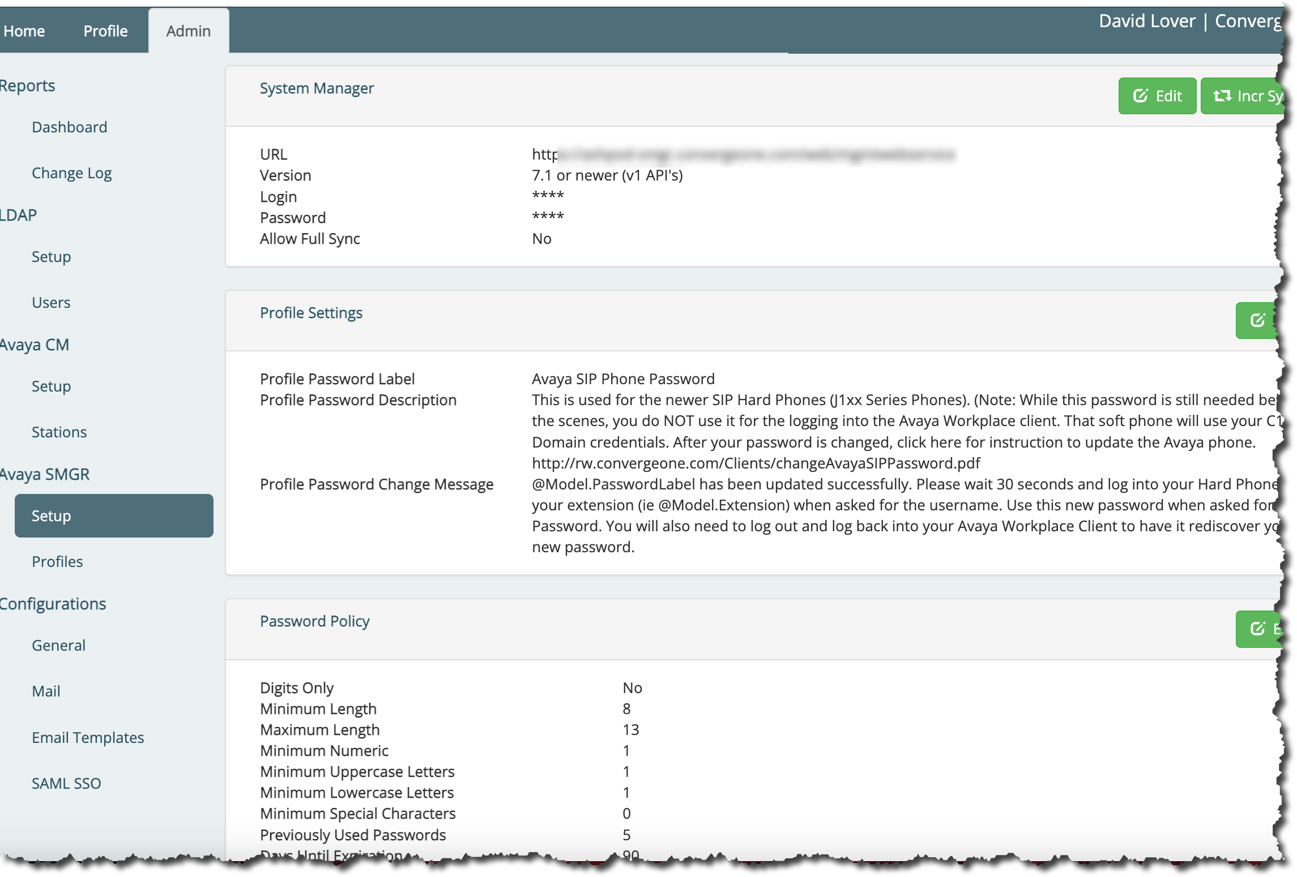
System Manager Configuration
PasswordPro accesses customer’s Avaya Aura System Manager via the premises based PasswordPro Gateway through HTTPS based API.

Slide 47
C1cx PasswordPro
High Level Architecture and Data Collection
The main PasswordPro servers in the C1CX Data Center will pull the following user data, via the on-prem gateway:
From LDAP, it will pull the user’s first and last name, the email address, and phone number (generally stored in the telephoneNumber field).
From System Manager, it will pull the user’s first and last name, their “E.164” communication address, and the “Avaya SIP” communication address.
From Communication Manager (optional), it will pull the username and the station extension.
C1CX Data Center
C1CX SAML Proxy
Customer's IdP
LDAP/S
Email Server
SMTP Relay
TCP/TLS

Slide 48

C1CX PasswordPro Benefits
  A critical component in protection of user’s telephony accounts
  Enforces compliance to password complexity and expiration policies
  Provides 24x7 availability for password resets without the need for additional headcount
  Fully automate your password reset process and free up help-desk resources

Slide 49

Questions / Comments / Applause / Boos…

Slide 50

What’s the best way for you to get help with password and single sign on?
Find the best partner – here at the show!
Please fill out your session survey! Session 1050
Come ask us questions
Call us – 888-777-7280
Check us out online – www.convergeone.com
Thanks for attending!
Dave Lover Chris Clauss
dlover cclauss
@convergeone.com

